Slide 1
Principles of Drug Discovery
Lecture 2: Protein Structure
Notes:
4/25/17
1
1

Slide 2
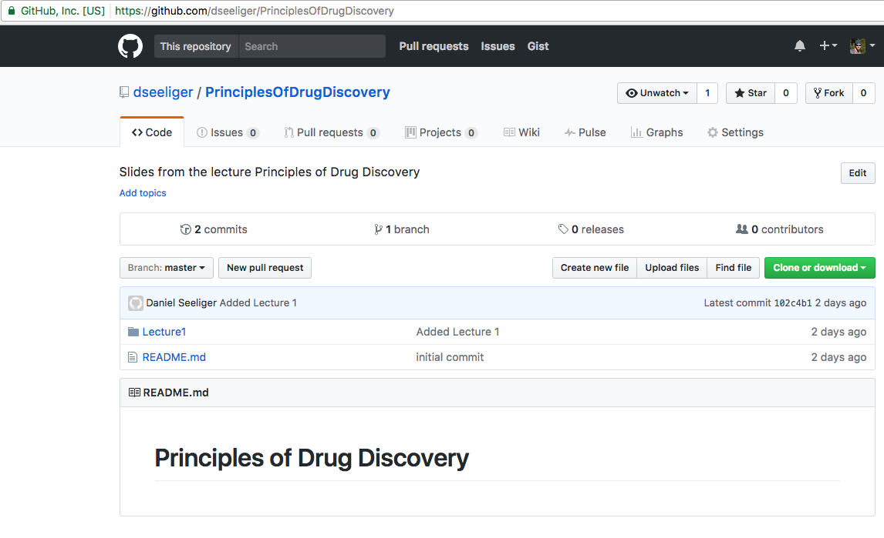
Lecture materials available on https://github.com/dseeliger/PrinciplesOfDrugDiscovery

Slide 3

Examination Date?
Written exam on July 11th

Slide 4
Proteins are involved in all processes in living organisms
Proteins are responsible for:
Catalyzing chemical reactions (enzymes)
Regulation of cells
Communication between cells
Structural integrity
Transport of gases, ions, nutrients, fatty acids,……
Storage
Motion
Human diseases are often associated with dysregulated or malfunctioning proteins
Consequently, almost all drugs act on proteins

Slide 5
Notes:
Proteins can act as building blocks to form higher order structures
Proteins bind small molecules for the purpose of transport, signalling or in order to catalyze chemical reactions
They form all kinds of complexes with other macromolecules, e.g. other proteins, DNA or RNA
Some proteins are soluble and locate either in the cytosol or in extracellular matrices, e.g. blood
Others are associated with membranes or integrated into biological membranes
The envelope of viruses also contains of proteins

Slide 6
Amino Acids-The Building-Blocks of Proteins

Slide 7
[
]
ζ
δ
β
n
Amino group
ε
γ
α
Carboxylic acid group
The building blocks of proteins are amino acids
All amino acids which are used by organisms to build proteins are α-amino acids
Not all amino acids which have a physiological role are α-amino acids
α-amino acid
Notes:
Proteins consist of 20 different amino acids
All protein-building amino acids are alpha-amino acids, which means the amino group sits next to the carboxylic acid group
There are other amino acids which play physiological roles but these are not used as building blocks for proteins

Slide 8
[
]
[
]
n
n
Amino group
Carboxylic acid group
Reaction requires activation of the carboxyl group, e.g.
Acid chloride (chemistry)
Enzyme (biochemistry)
- H₂0
[
]
[
]
n
n
Notes:
Amino acids are bifunctional building blocks which means they can form chains consisting of several amino acids. These are called peptides or oligo-peptides or, if the chain is longer, protein. (There is no strict definition at which length a peptide is protein).
The peptide bond is formed by nucleophilic attach of the amine on the carbonyl carbon. This reaction does not happen spontaneously but requires activation of the carboxylic acid. In chemical synthesis this is usually done via acid chloride, during protein synthesis inside cells this happen through enzymatic activation.

Slide 9
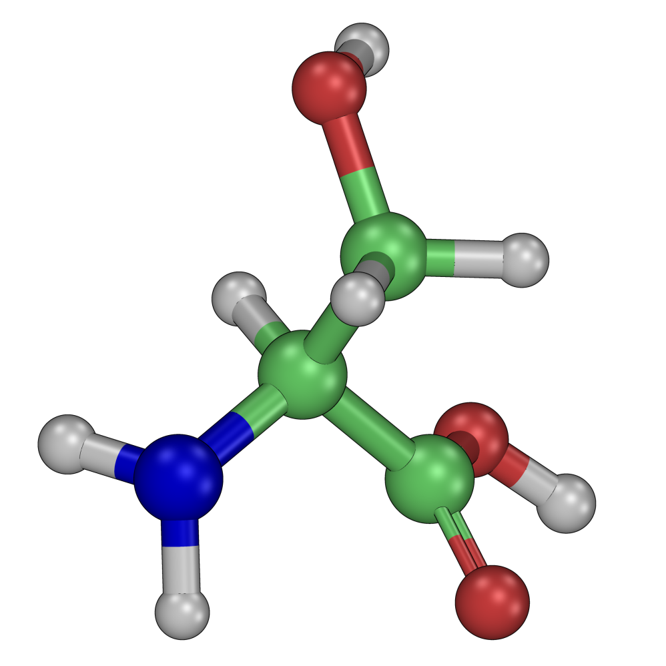
Glycine
Alanine
Serine
Cysteine
Threonine
All amino acids used to build proteins are L-amino acids, except for Glycine, which is non-chiral
Chiral center at Cα
Notes:
All protein-building amino acids except for glycine are chiral with a chiral center at the C-alpha atom
All amino acids are L-amino acids. The configuration is S except for cysteine, which is R but the sidechain points into the same direction

Slide 10
Aliphatic Amino Acids
Alanine
ALA / A
Valine
VAL / V
Leucine
LEU / L
Isoleucine
ILE / I
Actually not aliphatic but similar properties (hydrophobic)
Methionine
MET / M
Notes:
In total there are 20 protein-building amino acids which can be categorized by the physicochemical properties of their sidechains
Alanine, with a methyl sidechain
Valine contains an isopropyl SC
Leucine and Isoleucine have an isobutyl SC. LEU is branched at the Cgamma, ILE already at the Cbeta
Methionine contains an unbranched sidechain with a thioether.

Slide 11
Aromatic Amino Acids
Histidine
HIS / H
Phenylalanine
PHE / F
Tyrosine
TYR / Y
Tryptophane
TRP / W
Notes:
There are four amino acids with aromatic sidechains where the aryl group always is attached to the Cbeta atom
His contains an imidazole group (5-membered ring with two nitrogens)
Phenylalanine contains a simples phenyl ring
Tyrosine has a para-phenol group as sidechain
Trp is the largest amino acid with an indole group as sidechain

Slide 12
Polar Amino Acids
Serine
SER / S
Threonine
THR / T
Asparagine
ASN / N
Glutamine
GLN / Q
Notes:
There are four amino acids which fall into the category polar:
Serine, with a primary alcohol at the Cbeta atom
Threonine contains a secondary alcohol
Asparagine has a primary amide at the Cbeta
And Glutamine contains also a primary amide but the sidechain is longer by one atom

Slide 13
Basic Amino Acids
Lysine
LYS / K
pKa ~ 10.5
Usually positively charged in proteins
Arginine
ARG / R
pKa ~ 12
Histidine
HIS / H
Protonation depends on local environment
pKa ~ 6
Notes:
Lysine contains a very long sidechain with a primary amine at the end. With a pKa of 10.5 is usually protonated and therefore positively charged.
Arginine also has a long sidechain with a guanidinium group at the end. With a pKa of 12 is also protonated and positively charged
Histidine, which we already classified as aromatic amino acids can also be put into this category since with a pKa of 6 it can be protonated (charged) or deprotonated (neutral). The pKa of amino acids depends heavily on the local environment.

Slide 14
Acidic Amino Acids
pKa ~ 4
Aspartic Acid
ASP / D
pKa ~ 4.5
Glutamic Acid
GLU / E
Usually negatively charged in proteins
Notes:
There are two amino acids with carboxylic acid sidechains which in most cases are deprotonated and therefore carry a negative charge

Slide 15
Special Amino Acids
Disulfide Bond (oxidized)
Thiol
Thiolate
Cysteine
CYS / C
pKa ~ 8
Proline
PRO / P
No H-donor in peptide chain
Restricted conformational flexibility
Glycine
GLY / G
No sidechain
High conformational flexibility
Notes:
Cystein is special in a way that it contains a thiol group which can in some environments be deprotonated.
In many proteins cysteine residues are oxydized and form a disulfide bridge with a second cysteine.
Proline is special since it is the only amino acid which contains a secondary amine (pyrrolidine ring). This has two effects: The conformational flexibility is restricted due to the presence of the ring and, when part of a protein chain it does not chain a NH-group anymore to form hydrogen bonds
Glycine does not contain a sidechain and is the only non-chiral amino acid.

Slide 16
Notes:
All 20 canonical amino acids at a glance.
The sidechains of the 20 amino acids have different physiochemical properties and preferences to form interaction with other molecules.

Slide 17
Alanine | ALA | A
Cysteine | CYS | C
Aspartic Acid | ASP | D
Glutamic Acid | GLU | E
Phenylalanine | PHE | F
Glycine | GLY | G
Histidine | HIS | H
Isoleucine | ILE | I
Lysine | LYS | K
Leucine | LEU | L
Methionine | MET | M
Asparagine | ASN | N
Proline | PRO | P
Glutamine | GLN | Q
Arginine | ARG | R
Serine | SER | S
Threonine | THR | T
Valine | VAL | V
Tryptophan | TRP | W
Tyrosine | TYR | Y
Notes:
4/25/17
17
17
When working with proteins, usually abbreviations are used for the canonical amino acids
There is three-letter code and a one letter code. The one-letter code is commonly used to represent a peptide or protein sequence as a single string.

Slide 18
Primary Structure
The primary structure of a protein is the order in which amino acids are connected (Sequence)
The sequence is encoded in the genome
The human genome (~3 billion base pairs) has been decoded in 2001.
About 1% of the human genome encodes for proteins
Notes:
There are different hierarchies for the description of proteins.
The primary structure denotes the order of amino acids in a protein chain. This order is encoded in the DNA, where each amino acid is represented by a triplet of nucleobases.
The regions which encode for a single protein chain on the DNA are often separated by non-coding parts. The regions which encode for a protein are called exons, non-coding regions are called introns.
In order to synthesize a protein, the DNA part which encodes for the protein (a gene) is first translated into RNA which then is again processed (spliced) and translated into messenger RNA (mRNA) in which the introns are removed.
The mRNA is then used as construction plan for the protein.
The human genome contains roughly 3 billion base pairs. It has been first decoded in 2001 which by then was a enormously laborious and expensive endeavor. Today DNA and RNA sequencing are standard techniques and due to technological advancements (Next Generation Sequencing) thousands of genomes have been decoded.
It is remarkable that, although proteins play such a pivotal role for living organisms, only 1% of the human genome actually encodes for proteins.

Slide 19
Database of Protein Sequences:
http://www.uniprot.org/
FASTA File Format
>sp|P68871|HBB_HUMAN Hemoglobin subunit beta OS=Homo sapiens GN=HBB PE=1 SV=2
MVHLTPEEKSAVTALWGKVNVDEVGGEALGRLLVVYPWTQRFFESFGDLSTPDAVMGNPK
VKAHGKKVLGAFSDGLAHLDNLKGTFATLSELHCDKLHVDPENFRLLGNVLVCVLAHHFG
KEFTPPVQAAYQKVVAGVANALAHKYH
>sp|Q05127|VP35_EBOZM Polymerase cofactor VP35 OS=Zaire ebolavirus (strain Mayinga-76) GN=VP35 PE=1 SV=1
MTTRTKGRGHTAATTQNDRMPGPELSGWISEQLMTGRIPVSDIFCDIENNPGLCYASQMQ
QTKPNPKTRNSQTQTDPICNHSFEEVVQTLASLATVVQQQTIASESLEQRITSLENGLKP
VYDMAKTISSLNRVCAEMVAKYDLLVMTTGRATATAAATEAYWAEHGQPPPGPSLYEESA
IRGKIESRDETVPQSVREAFNNLNSTTSLTEENFGKPDISAKDLRNIMYDHLPGFGTAFH
QLVQVICKLGKDSNSLDIIHAEFQASLAEGDSPQCALIQITKRVPIFQDAAPPVIHIRSR
GDIPRACQKSLRPVPPSPKIDRGWVCVFQLQDGKTLGLKI
Notes:
4/25/17
19
19
As of today thousands of proteins have been sequences and form a invaluable resource for life science research.
The sequence are publically available in several databases, e.g. uniprot.org. The most convenient way to represent protein sequences is the one letter code.
The most commonly used file format used one line to describe the protein sequence followed by he protein sequence in one-letter code.
This information is available for all human proteins, but what does it actually tell about proteins?

Slide 20
Notes:
The function of protein is defined by their 3-dimensional structure, which is determined by the sequence

Slide 21
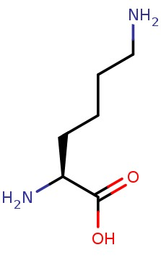
N-Terminus
C-Terminus
Nζ
Cε
Sidechain
3-Letter-Code: LEU-SER-PHE-MET-GLN-ALA
Cδ
Cγ
1-Letter-Code: LSFMQA
Cβ
Backbone
Cα
Notes:
4/25/17
21
21
A protein/peptide chain contains of a backbone, which is formed by the atoms forming the amide bond + the Calpha atom from the sidechains grow out.
The start of the protein chain is the N-terminus, the end is referred to as the C-terminus.

Slide 22
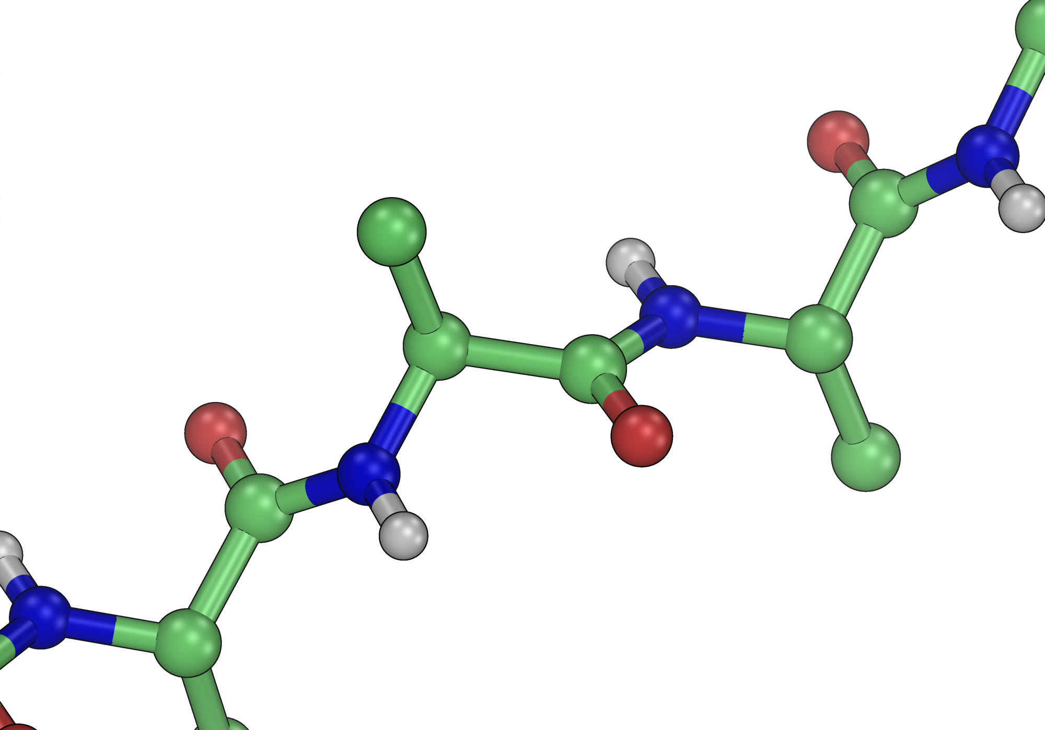
Secondary Structure
The secondary structure describes the local conformation of a protein chain
It is defined by the dihedral angles of the backbone (φ,ψ,ω)
ψ
φ
2D-Representation
3D-Representation
ω
Notes:
The primary structure is a one-dimensional information, which you also can represent as a 2D chemical depiction. These representations do not contain information about the conformation of the chain.
The secondary structure describes the local conformation of a peptide chain which is defined by the dihedral angles of the backbone.
There are three different dihedral angles forming the backbone: Omega (the peptide bond), Phi and Psi.

Slide 23
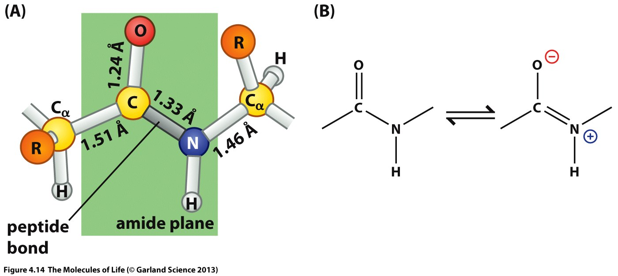
No rotation around amide bond
Notes:
The amide C-N bond is shorter than a C-C bond due to its partial double bond character.
The energetic barrier for a rotation around this bond is therefore very high which means that under physiological conditions, no rotation around the amide bond happens.

Slide 24
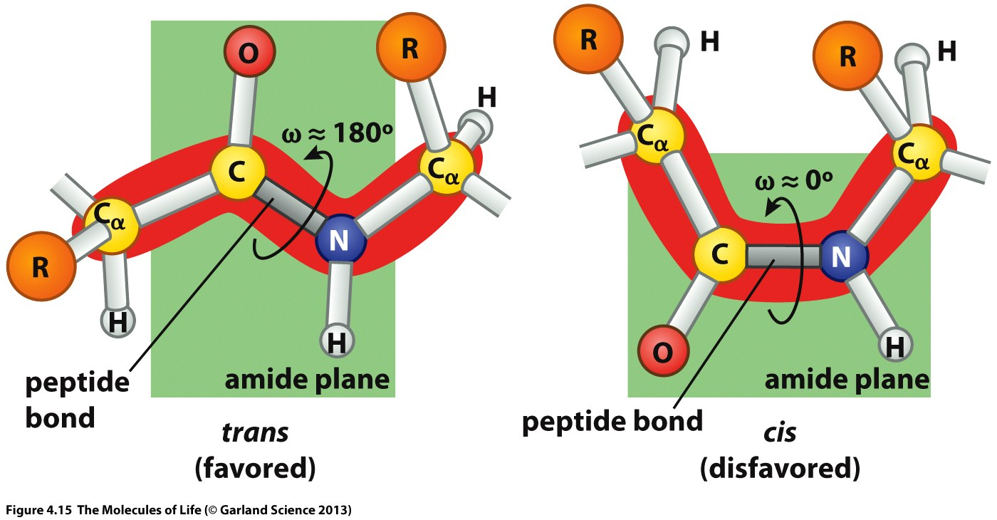
Notes:
For a planar amide bond there are two options, cis and trans.
In the cis conformation the two Calpha-atoms are in close proximity which is energetically disfavored. Therefore amide bonds in proteins are almost exclusively found in the trans conformation.

Slide 25
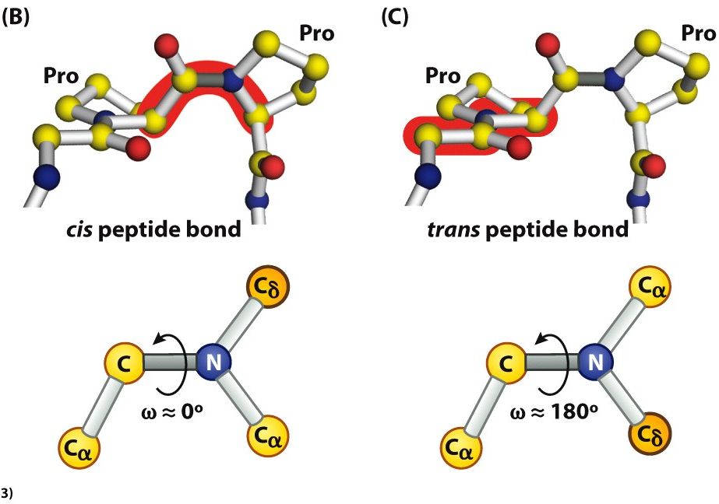
Notes:
An exception is proline. Here both options are found in proteins. However, the trans conformation is found more frequently.

Slide 26
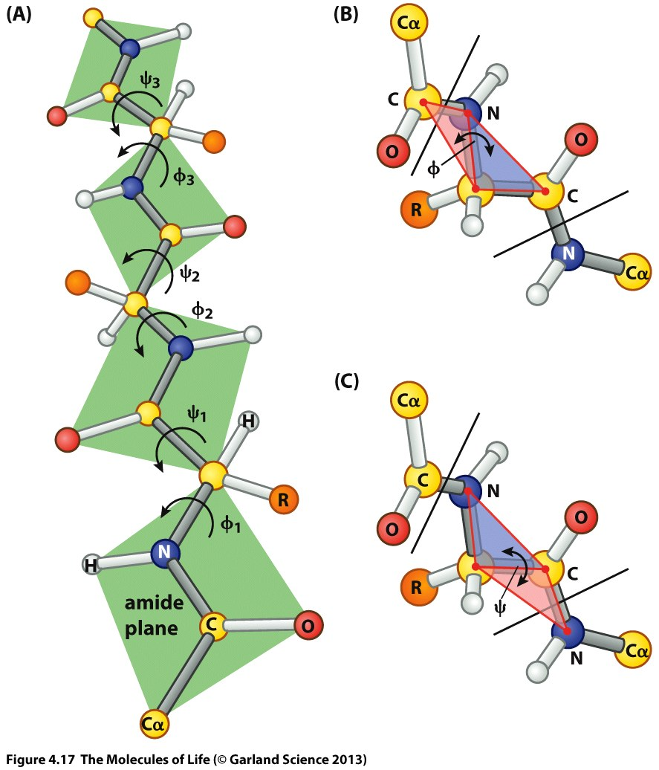
Notes:
The peptide group always forms a plane. The phi and psi angles of a peptide chains determine how the planes are oriented to each other.
The C-C and C-N bonds are single bonds and therefore allowed to rotate. However, not all conformations are possible due to steric hindrance.

Slide 27
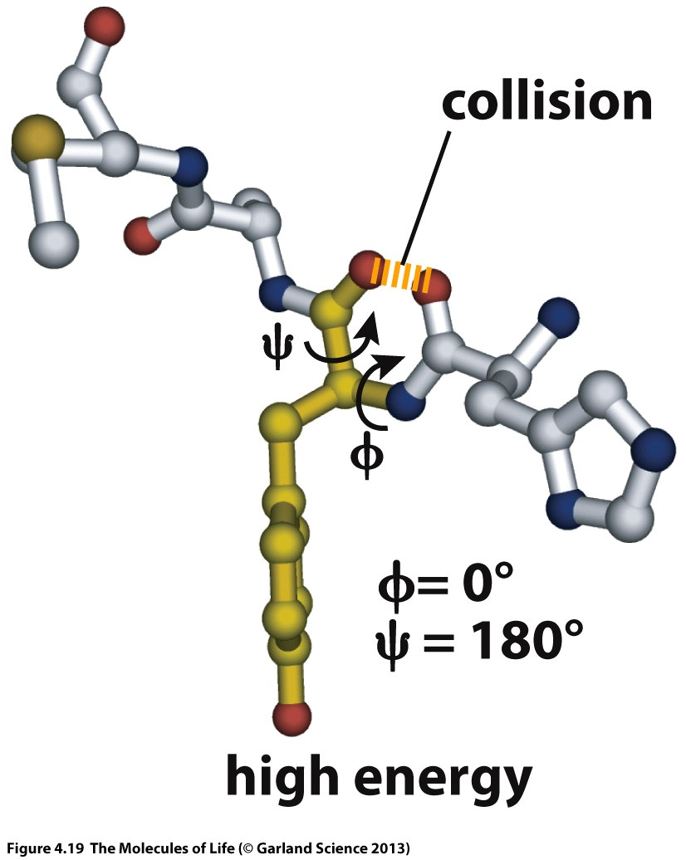
Notes:
Many combinations of phi/psi angles lead to very close distances of atoms which is energetically disfavored.
Therefore only a limited subset of all possible phi/psi combinations are allowed.

Slide 28
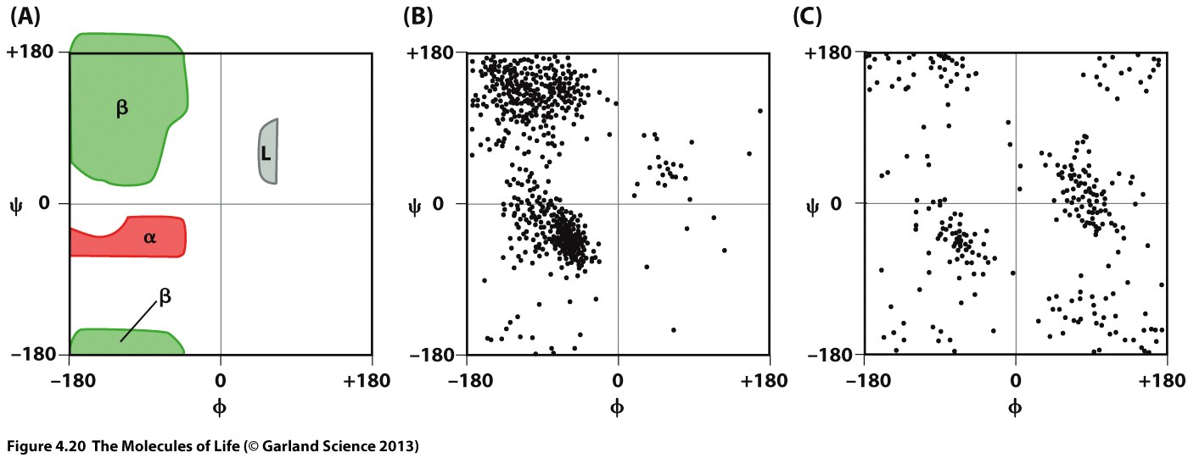
Ramachandran Plot
Glycine
Notes:
This interdependency of phi/psi angles is best visualized in a Ramachandran plot, where the phi/psi angles of each amino acid in a protein are plotted against each other.
Only a small subset of the total phi/psi space is actually populated. The asymmetry is due to the chiral nature of the canonical amino acids.
An exception is glycine, the only non-chiral amino acid. Since it does not have a sidechain it is conformationally less restricted and its Ramachandran plot is symmetric.

Slide 29
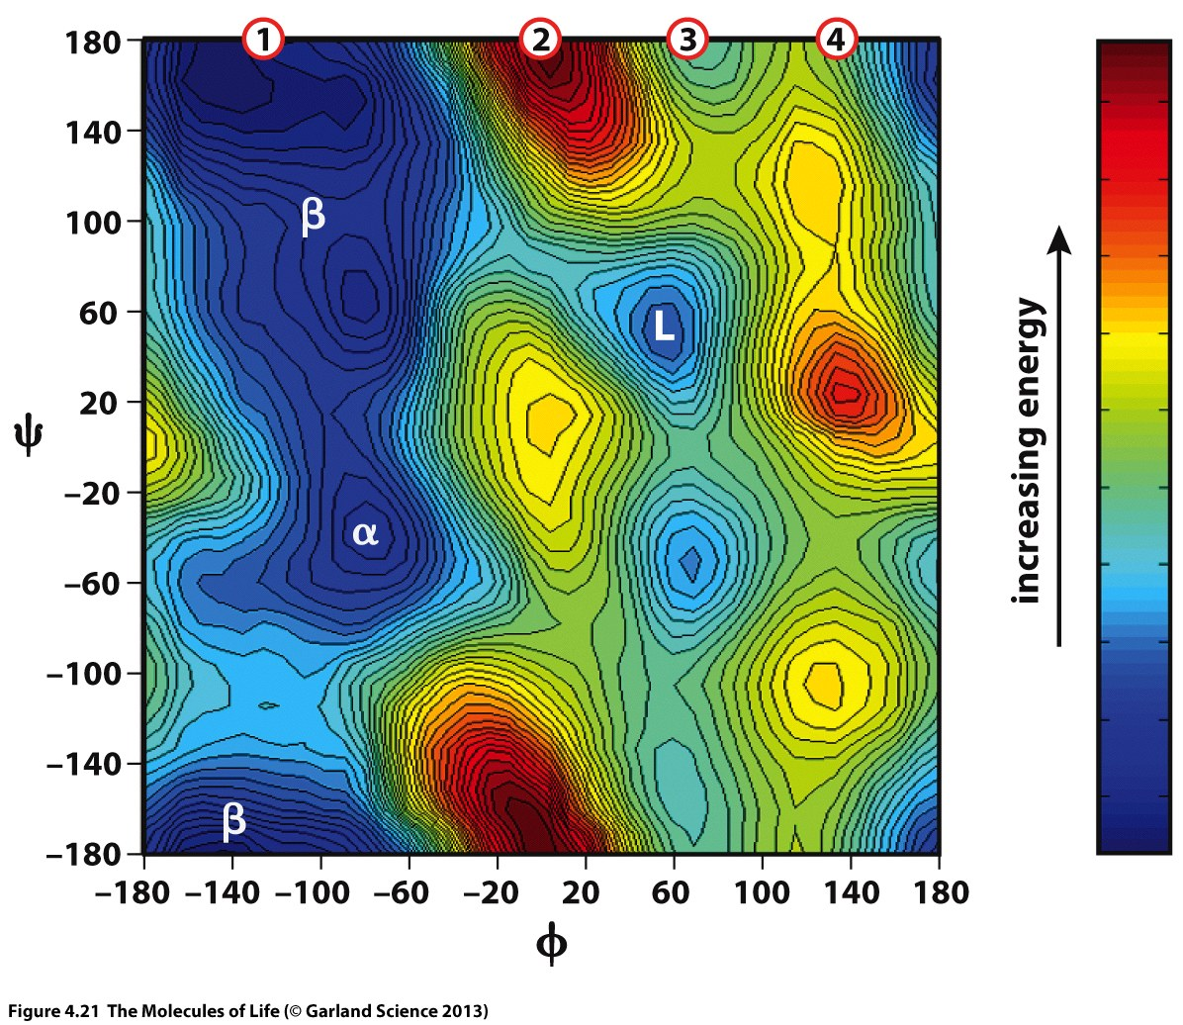
Notes:
The observed distribution of phi/psi combinations can be understood by looking at the energy landscape as function of the dihedral angles.
The possible local conformations of a protein backbone is largely determined by the interaction energy between direct neighbors.
If we keep the psi angle fixed and rotate around the phi angle this can be easily understood.

Slide 30
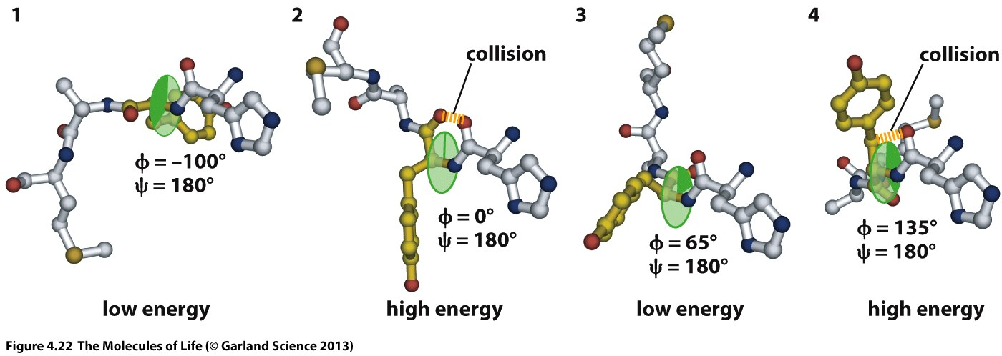
Notes:
Conformation 1 is energetically favorable
In conformation 2 the 2 carbonyl oxygens come in very close proximity which leads to high energy
Conformation 3 is better but not as good as conformation 1
Conformation 4 again leads to a clash

Slide 31
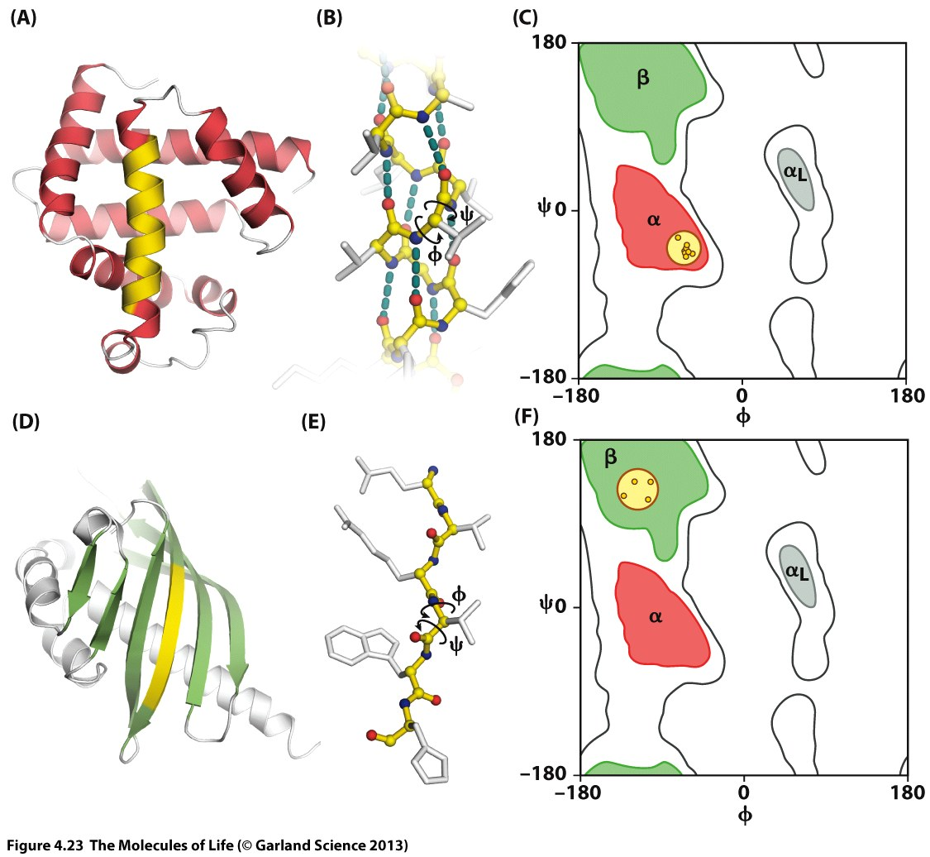
Notes:
Now we want to have a closer look at the preferred phi/psi combinations since these correspond to distinct secondary structure elements.
The region labeled as alpha corresponds to a phi/psi combination which brings the peptide chain into a helical arrangement. If several residues in a row adopt this conformation, the peptide forms a helical structure.

Slide 32
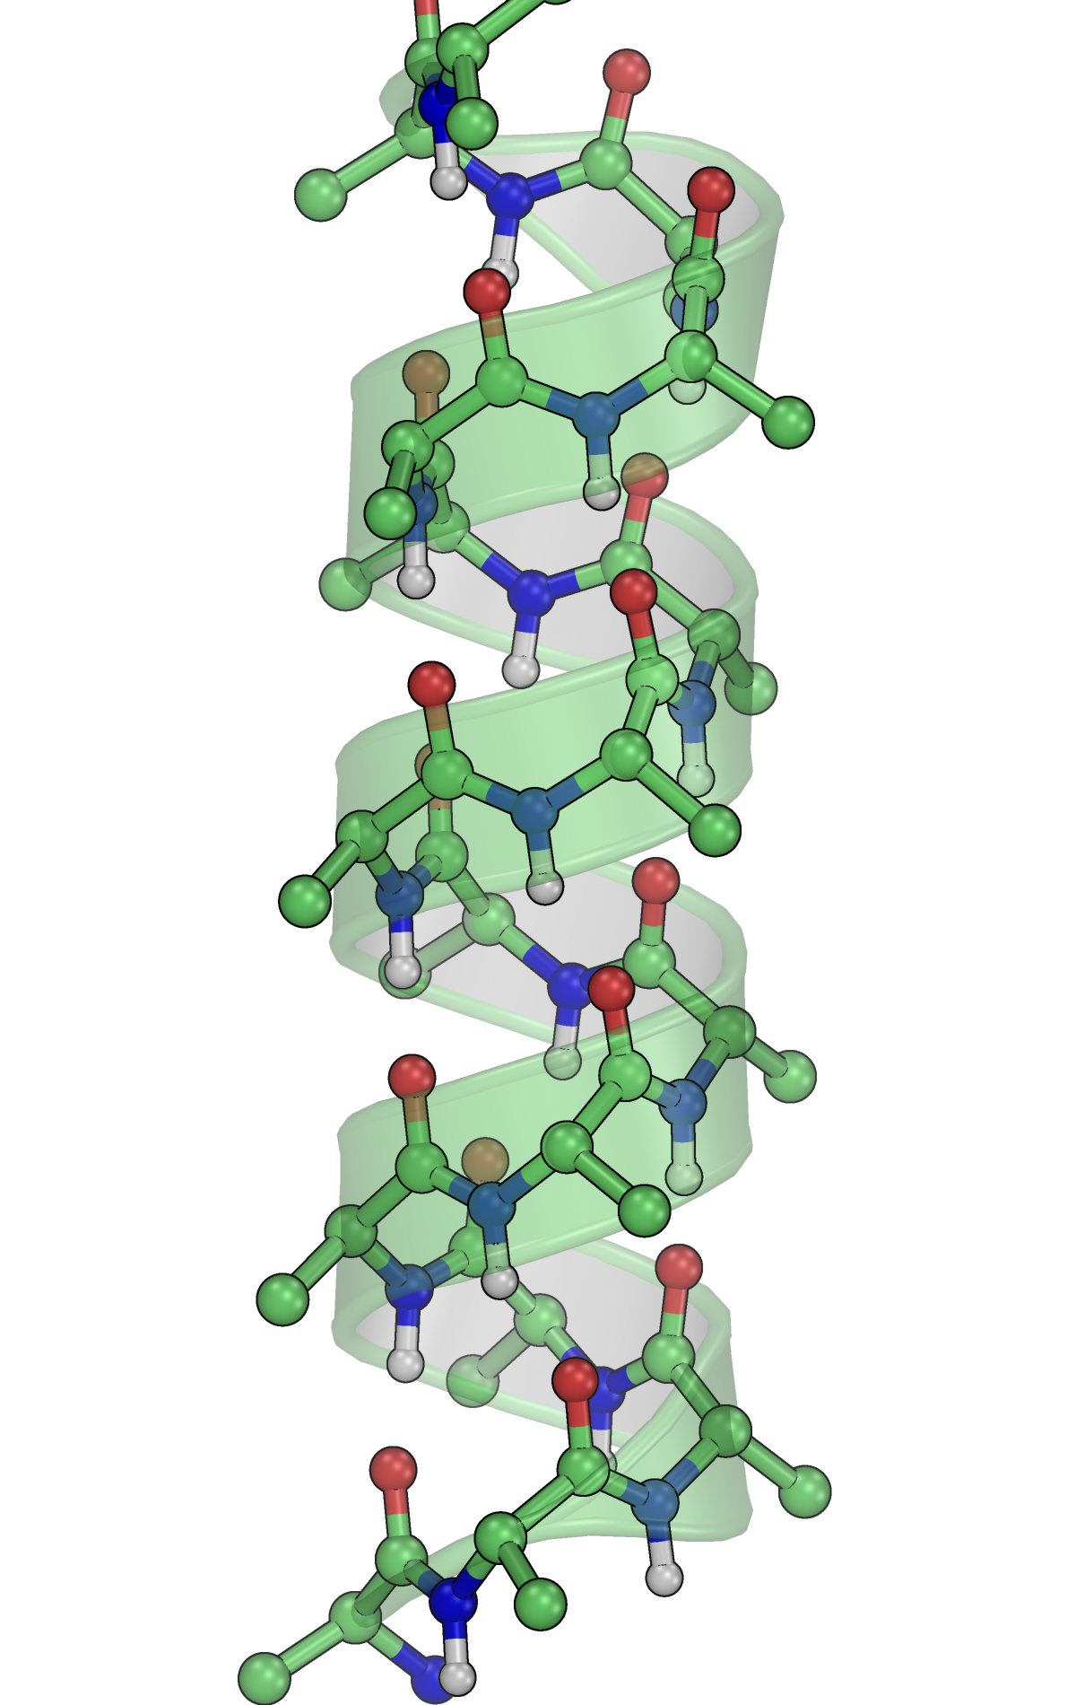
α-helix
3.6 residues per turn
Hydrogen bonds between residue i and i+4
Amide-H and carbonyl-O point into opposite direction
Sidechains point outwards
C-TER
N-TER
i
i+4
Notes:
4/25/17
32
32
The alpha-helix is the most frequently observed secondary structure element in proteins.
The phi/psi angles of the backbone lead to a helical arrangement in which 3.6 residues are needed to achieve a full turn.
The helical structure is stabilized by hydrogen bonds. Each residue i forms a hydrogen bond with residue i+4.
The sidechains in this secondary structure element point outwards like the branches of a tree
In representations of protein structures individual atoms are usually not shown. Instead a cartoon representation is used which emphasized the helical structure.

Slide 33
Notes:
The region labeled as beta corresponds to conformation in which the peptide chain is in an extended conformation. This conformation forms the basis for a secondary structure element called beta-sheet.

Slide 34
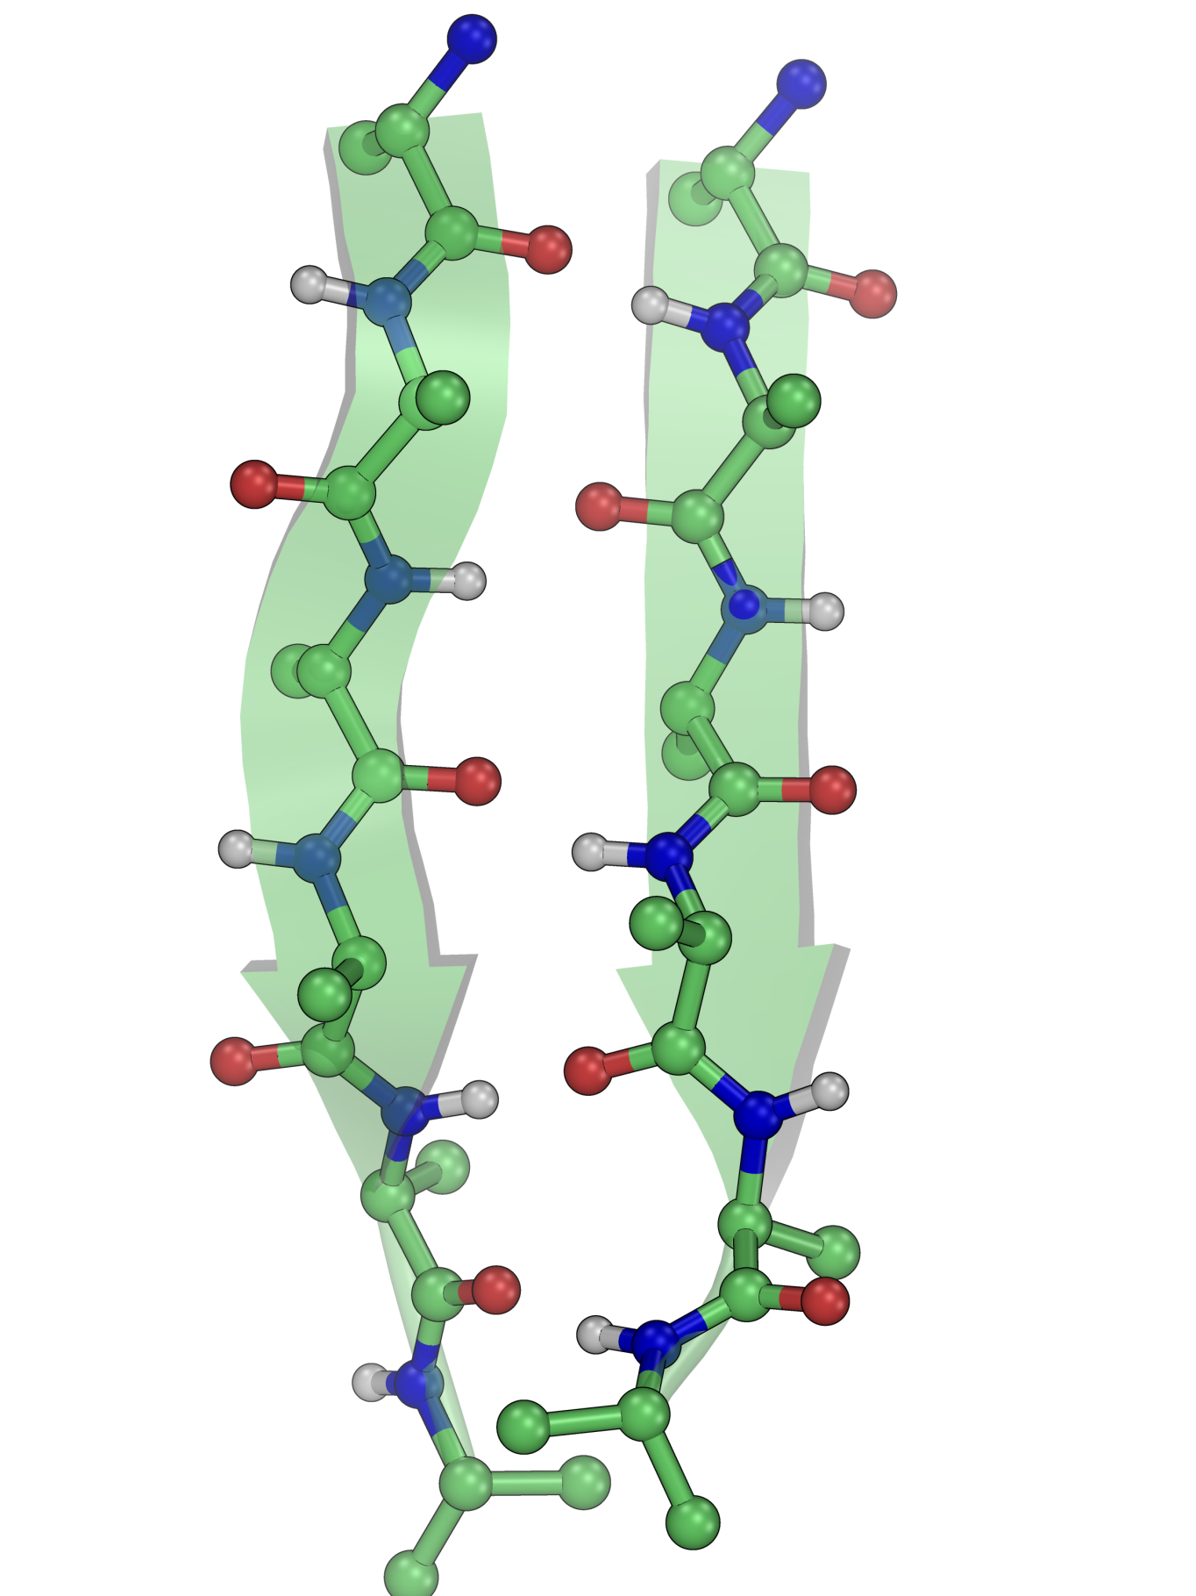
Parallel β-sheet
N-TER
N-TER
Extended conformation
Sidechains point alternatingly up and down
Amide-H and carbonyl-O point into same direction
C-TER
C-TER
Notes:
Beta-sheets, in contrast two alpha-helices do form hydrogens bonds with themselves but with a second strand.
There are two option how this second strand can be aligned with respect to the first, either parallel or anti-parallel.

Slide 35
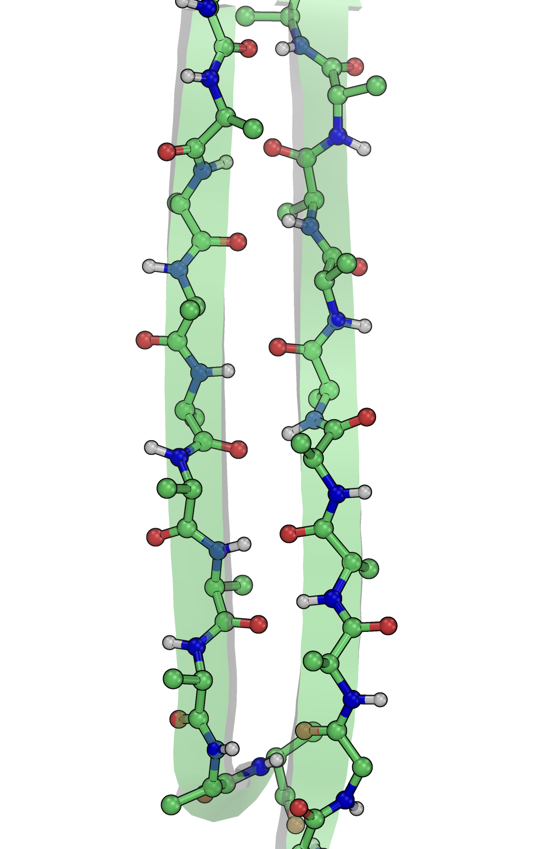
Anti-parallel β-sheet
N-TER
C-TER
Extended conformation
Sidechains point alternatingly up and down
Amide-H and carbonyl-O point into same direction
C-TER
N-TER
Notes:
In the anti-parallel beta-sheet the carbonyl-O and amide-H of the same amino acid form two hydrogen bonds with carbonyl-O and amide-H of the neighboring strand.
The donor and acceptor groups of the next amino acid point into the other direction which allows binding of the next strand.

Slide 36
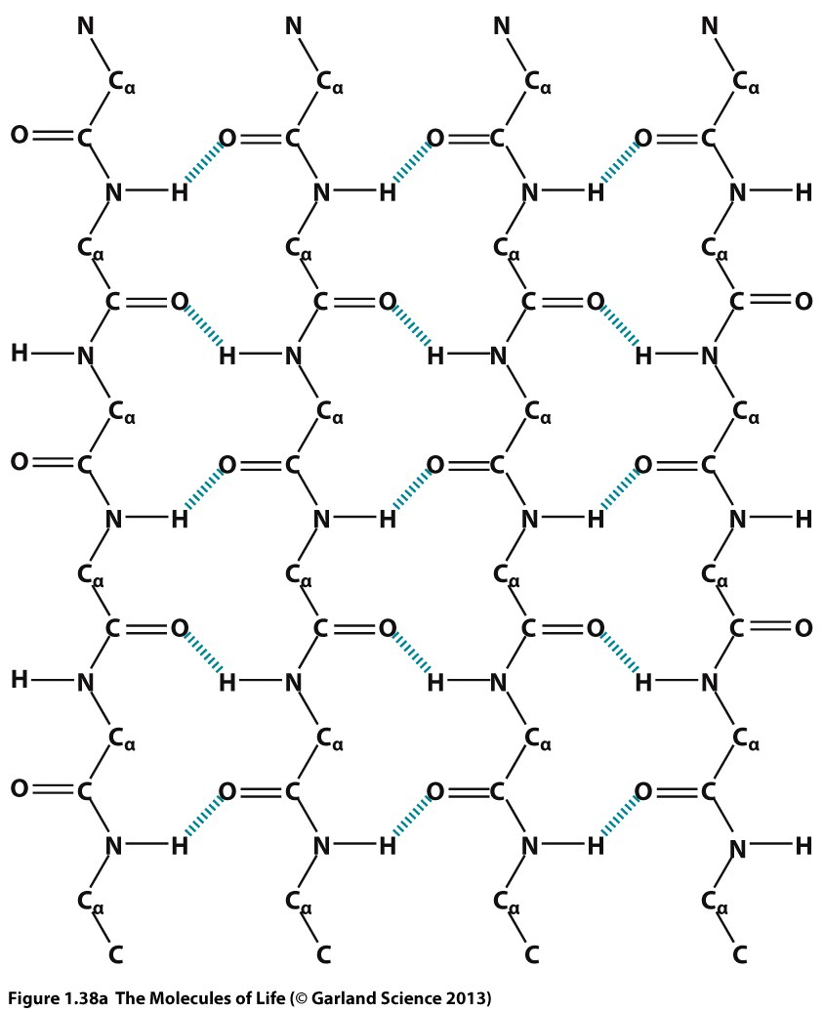
Notes:
Very often more than two strands are aligned next to each other forming higher order structures

Slide 37
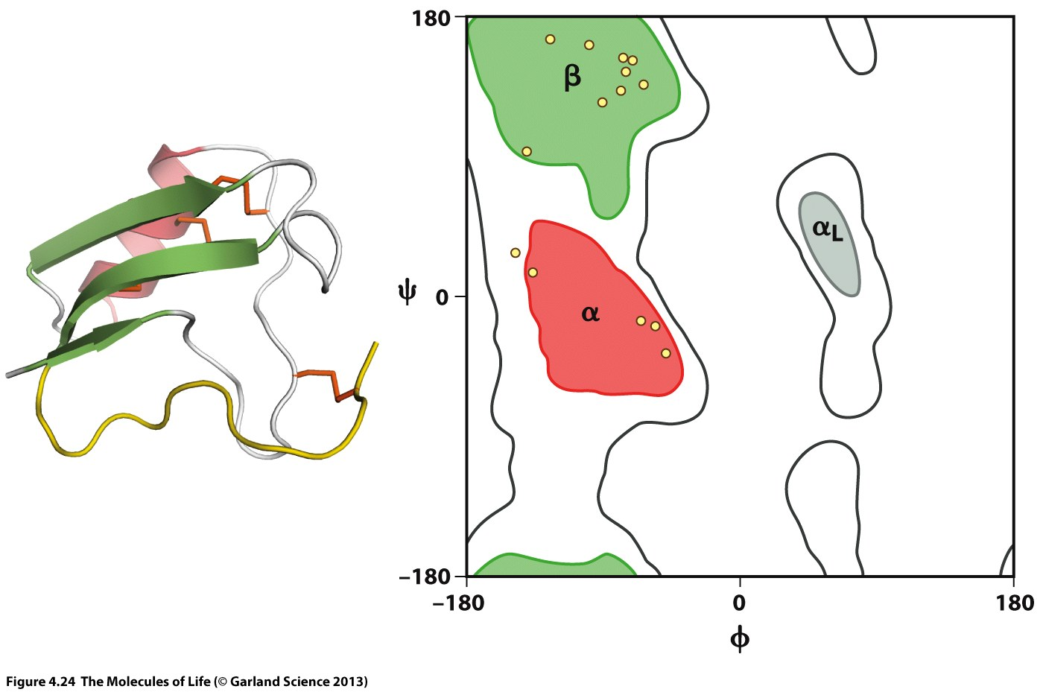
Notes:
Even regions in the protein which do not form a well-defined secondary structure element (loops) populate regions of the phi/psi space which belong to the low-energy regions.

Slide 38
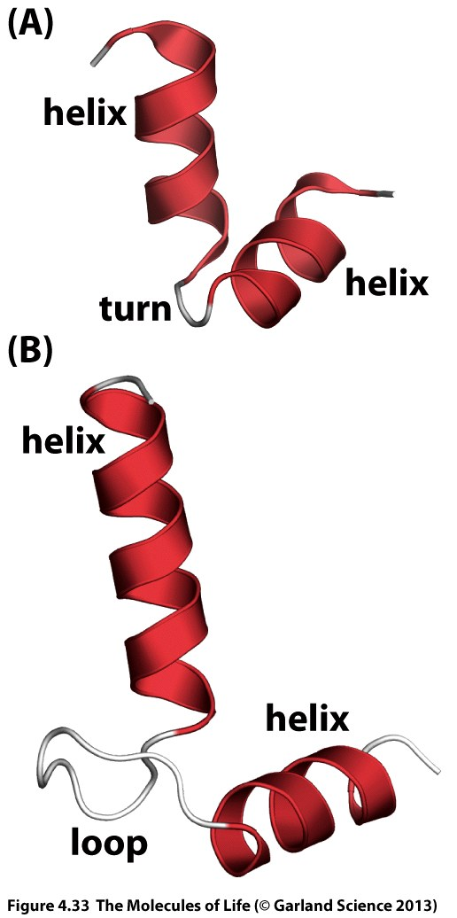
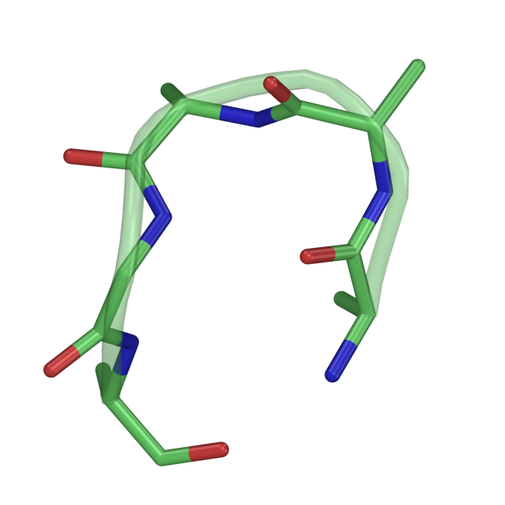
Other Secondary Structure Elements
3₁₀-Helix: Hydrogen bond between residue i and i+3 (3.0 residues per turn)
π-Helix: Hydrogen bond between residue i and i+5 (4.4 residues per turn)
Turn: 3, 4, or 5 turn
Notes:
Almost all protein contain helical or sheet structural elements or both
Besides these elements, there are other secondary structure motifs which are sometimes found, the 3-10 helix, which is more tightly wound form of a helix, and the pi-helix, where the hydrogens bonds are formed between residue i and i+5.
In addition turns are very frequently observed, which basically means that the peptide chain changes its direction
Regions which do not fall into any of these category are usually referred to as loops.

Slide 39
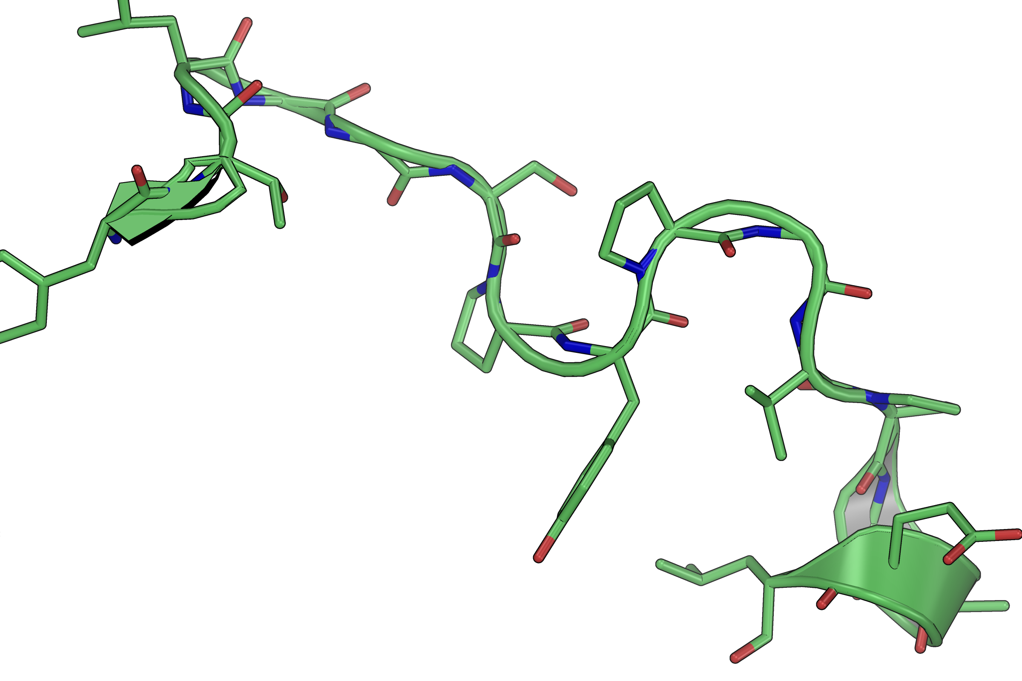
Loop / Disordered Structure
GLY
Very flexible
PRO
Restricted flexibility
No H-Bond donor
Notes:
Although loops do not fall into any secondary structure category they can be ordered and rather rigid
Other loops display a high degree of conformational flexibility
Amino acids which are frequently found in loops are glycine and proline. Glycine has more conformational flexibility than any other amino acid. Proline, due to the ring formation cannot rotate around the phi bond which reduces conformational flexibility.

Slide 40
Tertiary Structure
Notes:
The secondary structure describes the local conformation of the peptide chain based on dihedral angles and hydrogen bond patterns
The tertiary structure describes how different secondary structure elements are arranged and how the overall structure of the peptide chain looks like

Slide 41
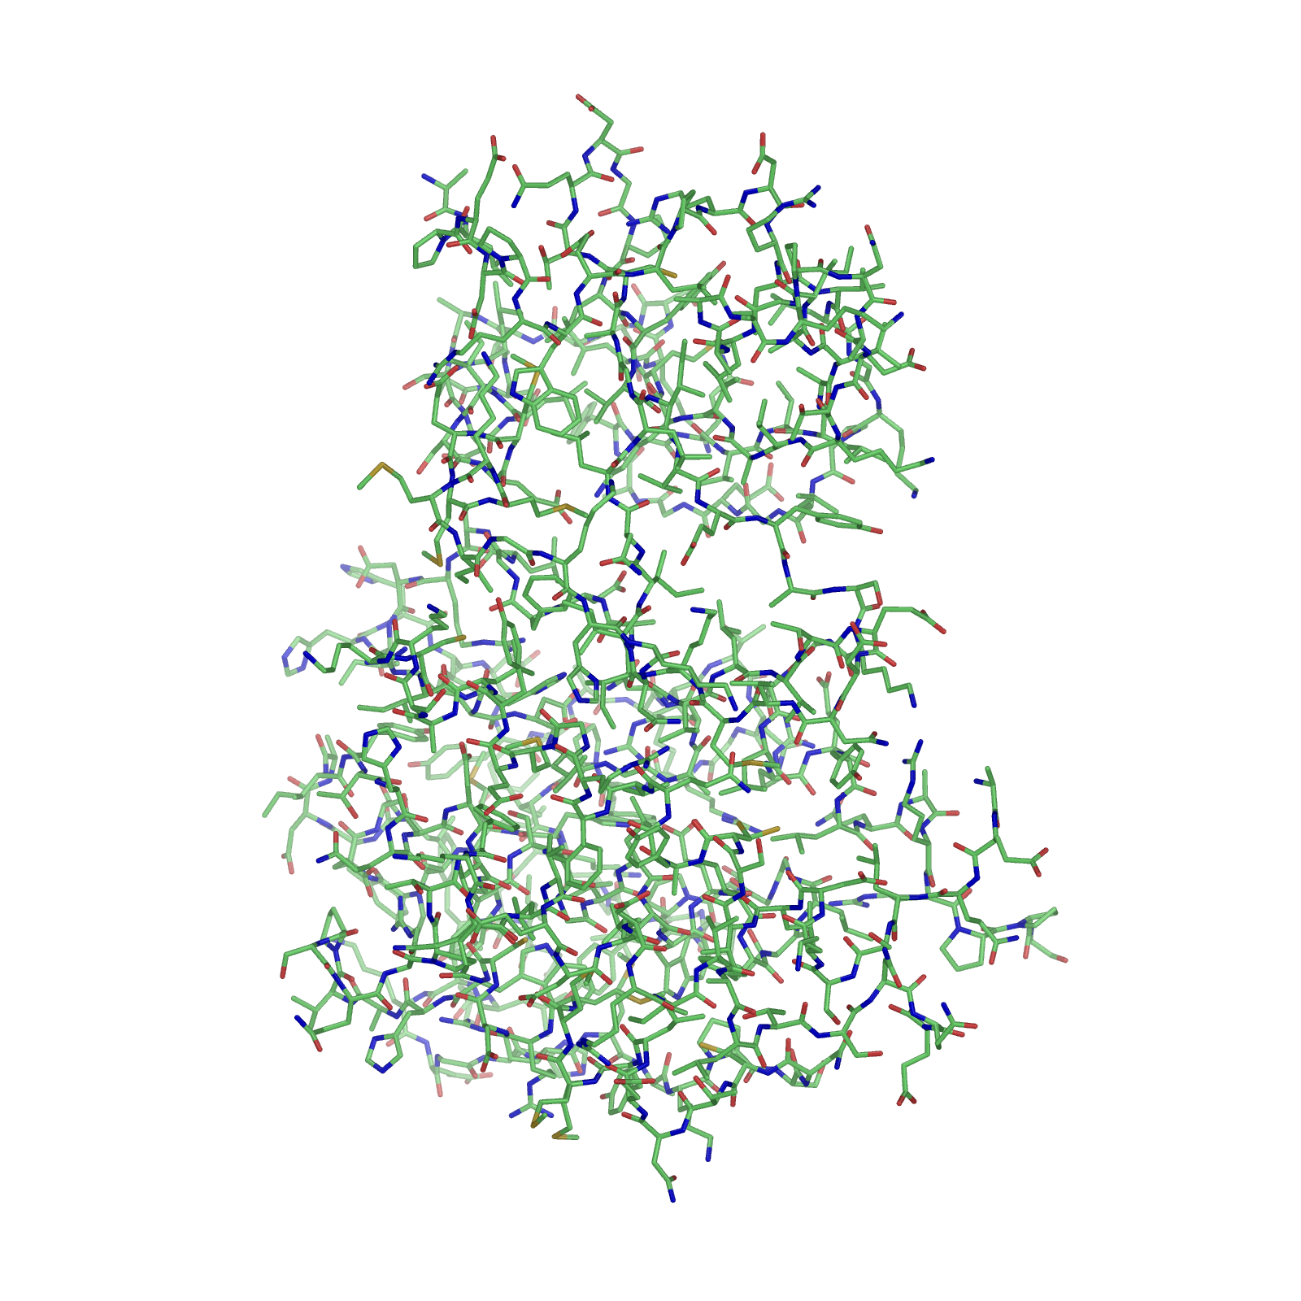
Most protein chains fold into well-defined 3-dimensional structures
Protein structure is essential for function
The fold of a protein chain is determined by the free energy of folding
The folded state of a protein represents the global minimum of the free energy landscape
3D-Structure of a protein
Notes:
Most proteins adopt a distinct 3-dimensional structure which is essential for proper function. If the protein loses its structure (denaturation) its function is lost.
The structure is solely determined by the sequence of amino acids a protein chain consists of
The folded structure represents the global minimum of the free energy landscape which is a function of intramolecular forces and interactions with the environment (water)

Slide 42
Molecular Driving Forces
Van-der-Waals interactions (induced dipoles)
Ionic interactions
Dipole-dipole interactions -> Hydrogen bonds
Hydrophobic effect
Notes:
The 3D-structure of a protein is a result of many interactions
Bonds and angles are rather stiff at physiological temperatures, so they don’t play in important role in the way a protein folds. The important forces are the so-called non-bonded interactions which we will discuss in the following

Slide 43
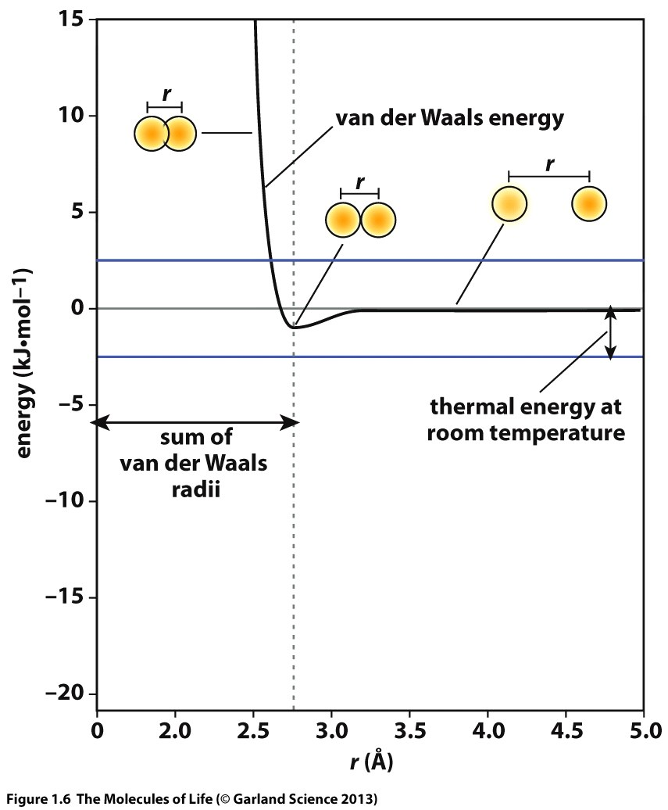
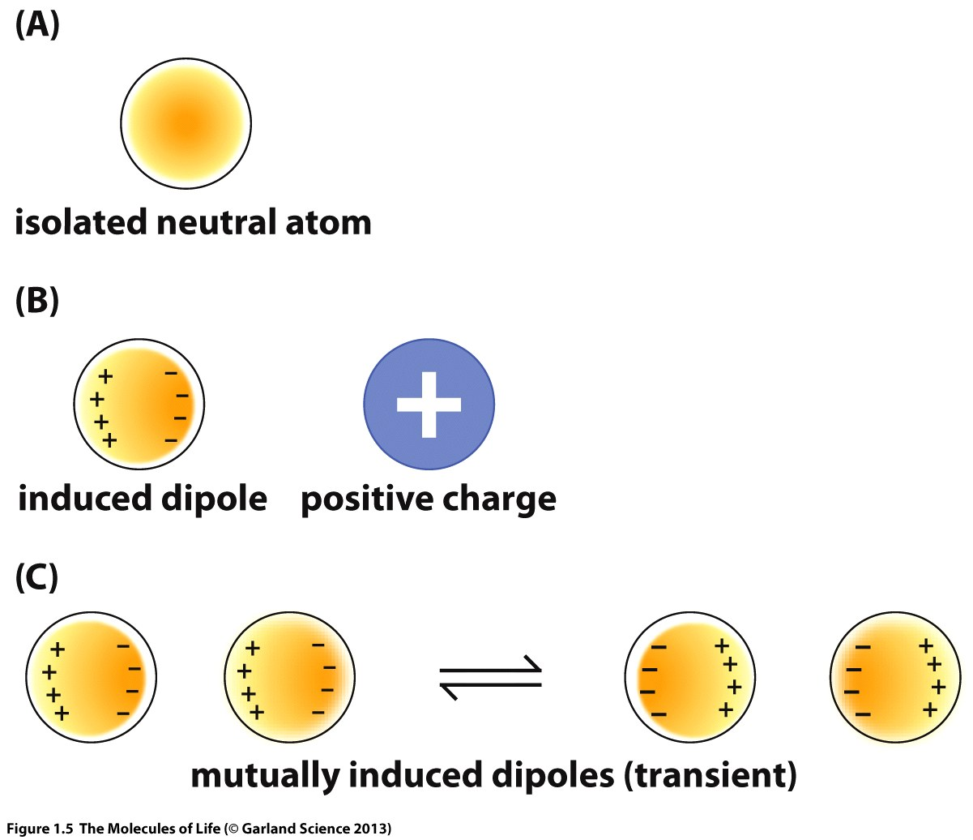
Van-der-Waals Interactions
Notes:
Van der Waals interactions are attractive forces which arise from induced dipoles. The energy minimum is dependent on the element type. Heavy atoms like bromine have a larger electron shell and are more polarizable than carbon or oxygen.
If the distance becomes too short the force becomes repulsive with distance dependency of the energy of 1/r12.
The attractive force is short ranged. It decays with 1/r6.

Slide 44
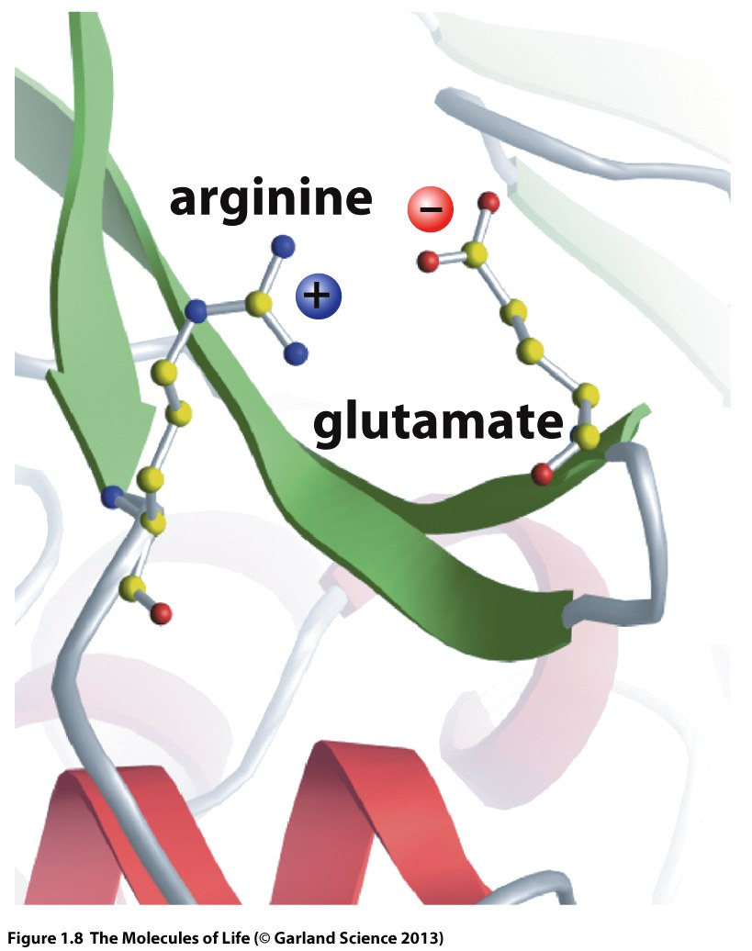
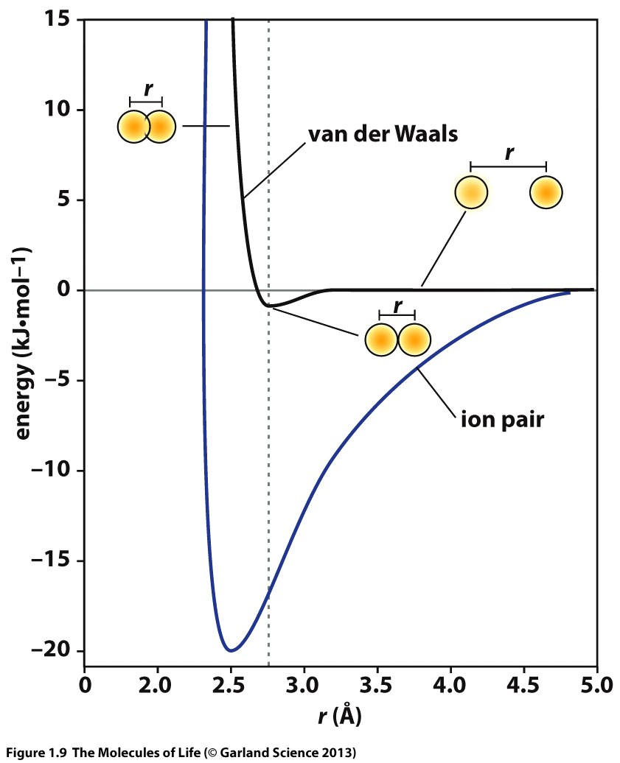
Notes:
Proteins also contain charged amino acids which can form ionic interaction.
Ionic interactions are much stronger than VdW attraction and long-ranged. The energy decays with 1/r. (Coulomb’s law).

Slide 45
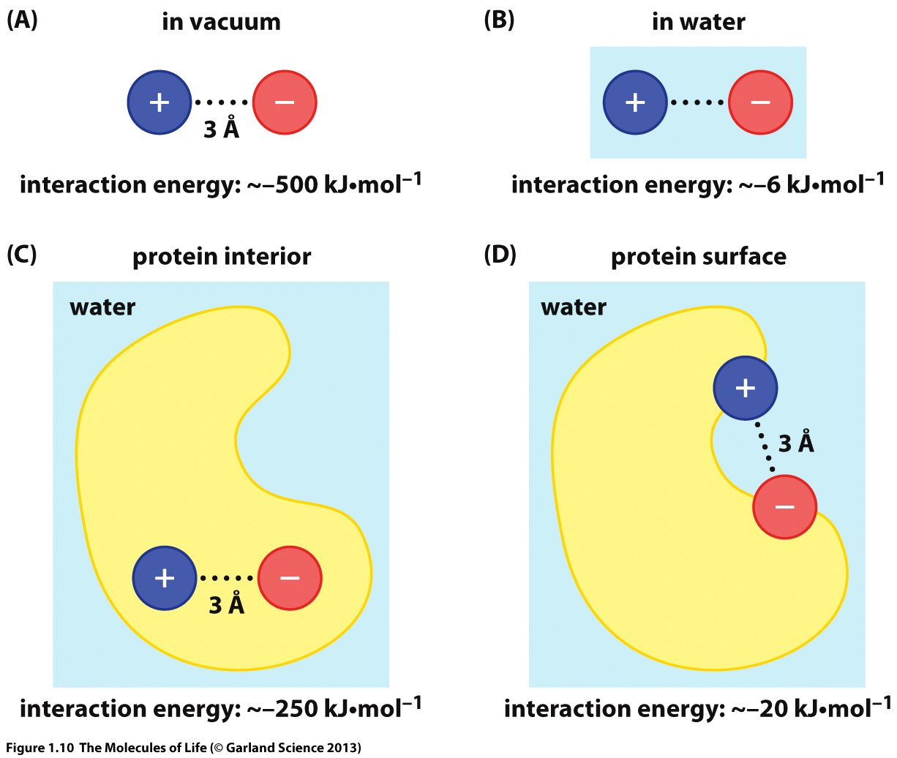
Notes:
In contrast to the VdW interaction the strength of ionic interactions are strongly dependent on the local dielectric. Water, with a high dielectric constant of 80 shields the Coulomb interaction which results in a much lower interaction energy as compared to vacuum.
Hence, in proteins is very important how the local environment of a ionic interaction looks like. The interior of a protein has dielectric constant which is closer to vacuum than to water.

Slide 46
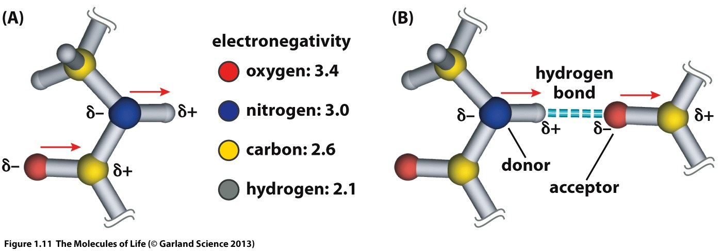
Dipole Interaction – Hydrogen Bonds
Notes:
The third driving force which is very important for protein structures are hydrogen bonds as we have already seen for the formation of secondary structure elements.
In contrast to ionic interactions dipole interactions have distance and a orientational component. The interaction is optimal of the angle between NH..O and CO..H are close to 180deg.

Slide 47
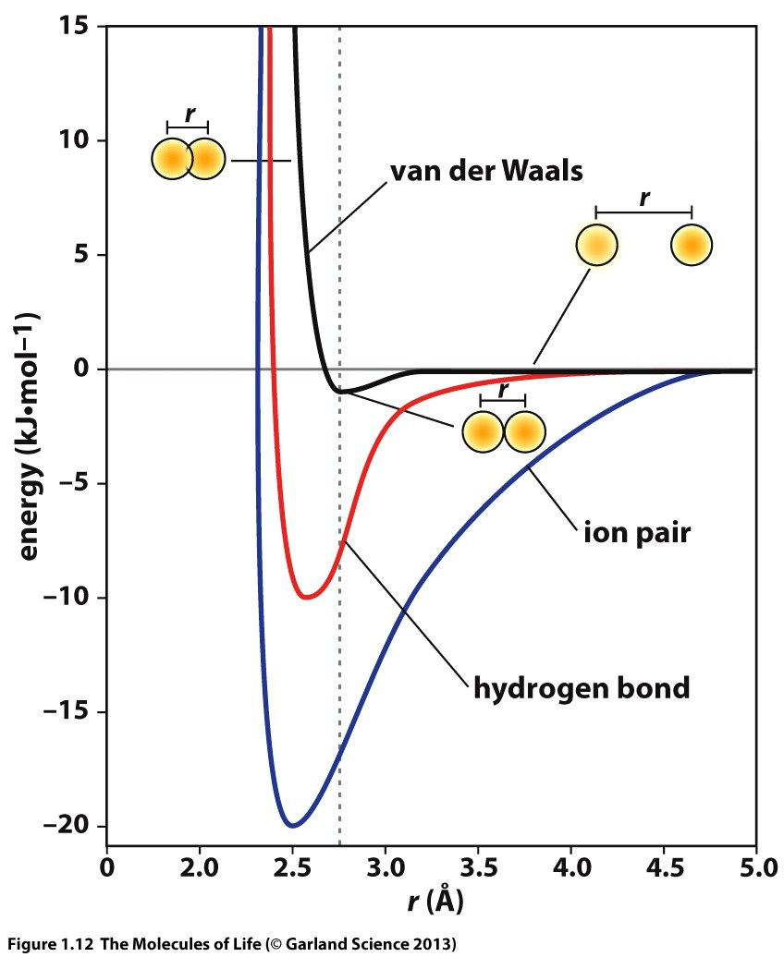
Notes:
The plot shows the strengths of different interaction types
The VdW energies are small but act between all atoms which are in close proximity. Their overall contribution to the total energy is therefore substantial.
The strengths of hydrogen bonds and ionic interactions are much larger but depend on the local environment.

Slide 48
Molecular Interactions in Proteins
Salt-bridges
Sidechain-backbone
hydrogen bonds
Backbone-backbone
hydrogen bonds
Ca²⁺
Enthalpy of a single hydrogen bond ~ 4-20 kJ/mol
Disulfide bonds
Sidechain-sidechain
hydrogen bonds
Ion coordination
Notes:
Amino acids can form hydrogen bonds with their backbone but the polar and charged amino acids can in addition form hydrogen bonds and salt-bridges with their sidechains.
In addition to these interactions the amino acid cysteine has the ability to form covalent bonds with a second cysteine residue. The formation of this bond requires oxidation of the thiol group.
Proteins also interact with a variety of metal ions, e.g. Ca2+, Fe2+,Fe3+,Co3+,Mg2+,Zn2+,….. The residues which form these binding sites are the classical metal complexing groups we now from chemistry. In the case of Ca2+ this is often His and Asp/Glu. Fe atoms are usually coordinated by His or Cys.

Slide 49
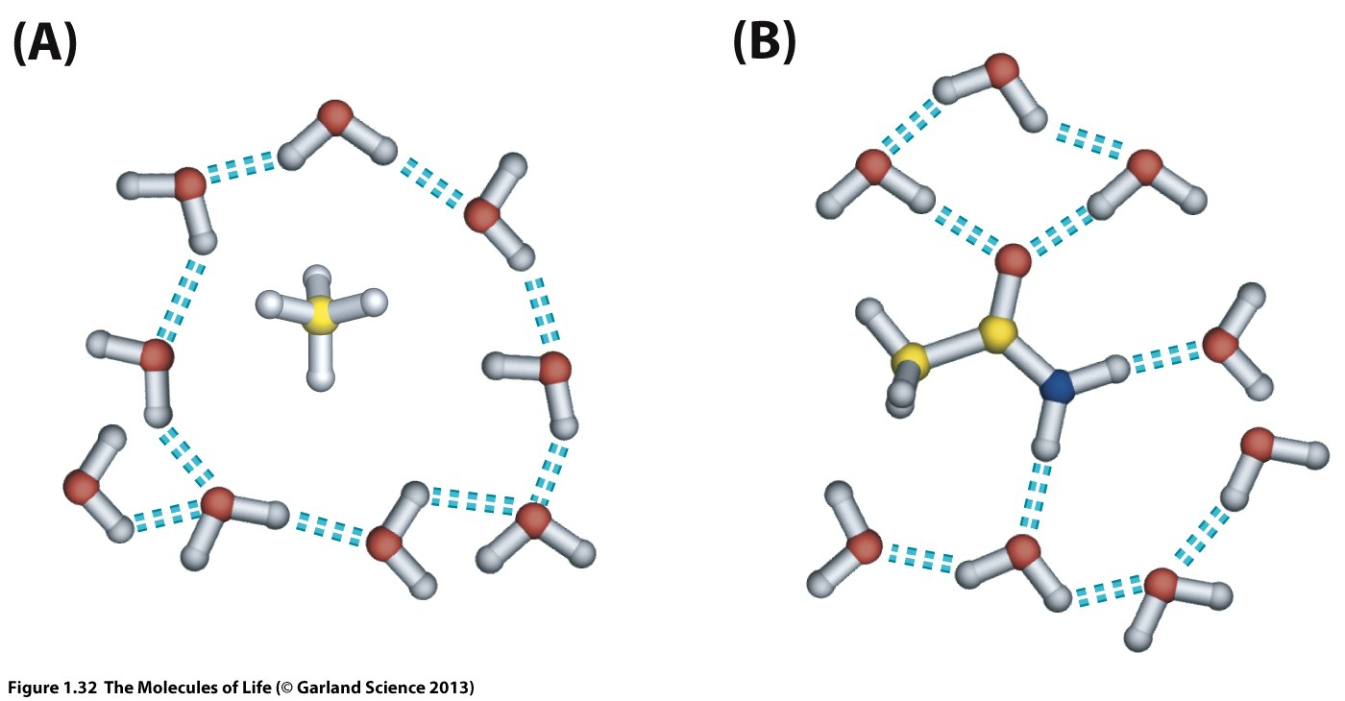
The Hydrophobic Effect
Notes:
The driving forces discussed so far are all enthalpic contributions to the free energy but there is another important driving force which contributes to the structure of proteins. This is called the hydrophobic effect.
What is the hydrophobic effect? Consider a non-polar molecule surrounded by water molecules which is not able to form hydrogen bonds with water. Since water molecules like to be involved in hydrogen bonds permanently and tend to change vary rapidly between partners, a non-polar contact reduces the number of options to form hydrogen bonds. This imposes an ordering of the water molecules around the non-polar molecule which denotes an entropic penalty. The result of this is phase separation as known from oil/water mixtures.
A polar solute which is able to form hydrogen bonds with water does not cause an entropic penalty

Slide 50
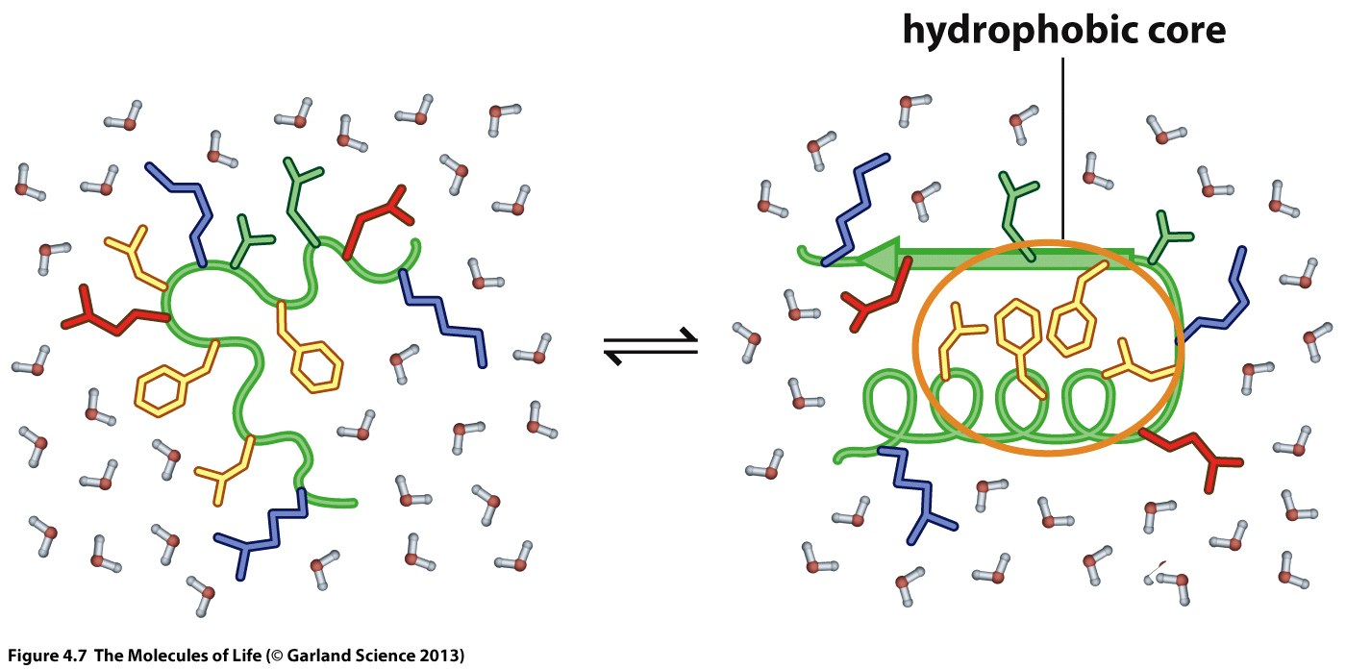
The Hydrophobic Effect
Many unfavorable hydrocarbon-water contacts
Unfavorable ordering of water molecules
Disordered protein chain is entropically favored
Less unfavorable hydrocarbon-water contacts
Less water molecules ordered
Ordered protein chain is an entropic penalty (-TΔS > 0 )
Notes:
Proteins contain many hydrophobic residues. In an unfolded protein chain these residues are in contact with water. Since these sidechains cannot form hydrogens bonds with water molecules their presence imposes an ordering of the water structure which denotes an entropic penalty
Folding of the protein chain into an ordered structure reduced the number of available conformations. This is entropically disfavored.
Folded (soluble) proteins usually have a hydrophobic core which means that they fold in way such that the majority of non-polar residues are buried inside an not exposed to the solvent.
Hydrophilic residues are primarily found at the surface of the protein and interact with surrounding water molecules

Slide 51
Notes:
The resulting folding free energy is the result of different contributions which are opposing each other.
Hydrogen bonds, VdW and electrostatic interactions make a strong enthalpic contribution the free energy
Burying hydrophobic side-chains in the protein core and reducing the interaction surface of non-polar amino acids with water also makes a stabilizing contribution to the folded state
Forcing a flexible protein chain with hundreds/thousands degrees of freedom into an ordered structure in which most of the DOF (rotatable bonds) are constrained denotes a large entropic penalty which opposes protein folding.

Slide 52
The 3-dimensional structure of a protein is the result of many enthalpic and entropic contributions
The folding free energy is rather small (~ -50 kJ/mol for a 10kD protein)
The 3D structure can be destroyed either by heat (-TΔS is always positive) or by chemicals (e.g. Urea). This is called denaturation.
Single mutations (amino acid exchanges) can have a substantial effect on the thermodynamic stability of proteins which is of great importance for many diseases, in particular inherited diseases.
Notes:
The result is a free energy differences which is rather small. As a consequence the 3-dimensional structure of proteins is not very resistant to heat and other destabilizing conditions.
Inherited diseases are often the result of a mutation in the DNA which translates into proteins which have a different amino acid in a certain position. In some cases this causes a massive destabilization of the protein, resulting in misfolding an dysfunction.

Slide 53
Quartenary Structure
Notes:
Tertiary structure describes the overall fold of a single protein chain.
However, proteins form many complexes which each other which can either be transient, meaning that the complex is formed, stays together for some time and then separates again.
Other complexes are virtually permanent, if once assembled they remain together for the entire lifetime of the protein. This assembly of several protein chains into higher order structures is called quarternary structure.

Slide 54
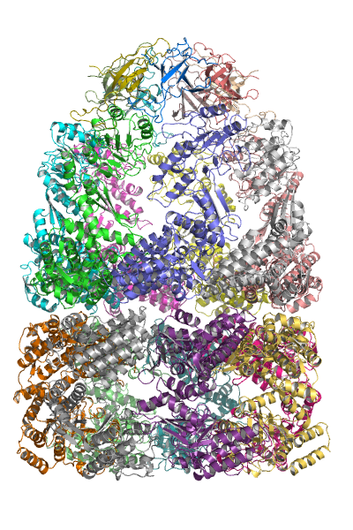
Several protein chains can assemble into multimeric complexes
These complexes can be multimers of the same protein chain or
assemblies of different protein chains
Notes:
Such protein assemblies can consist of only two chains but also of dozens of different protein chains. They can form homomers, assemblies of the same type of protein chain but also heteromers consisting of different types of chains.
The formation of these higher order structure is the basis for many molecular machines with complex function, e.g. the ribosome.

Slide 55
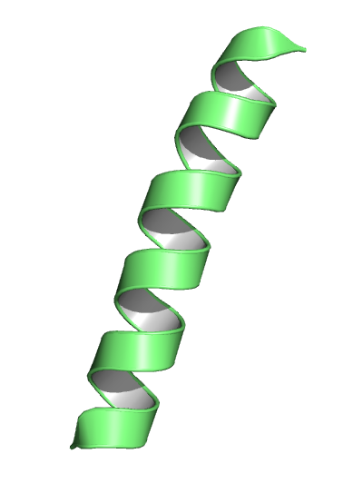
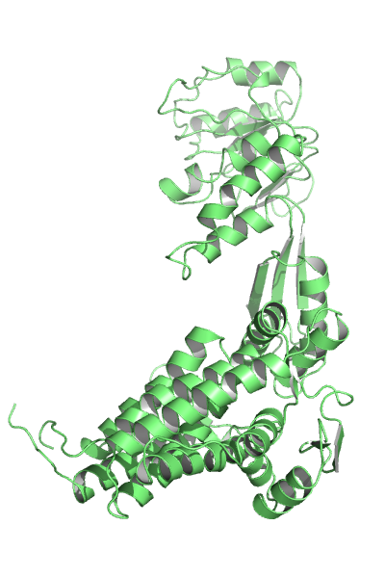
Primary Structure (Sequence)
LWGKVNVDEVGGEALGRLLVV
Secondary Structure
Tertiary Structure
Quarternary Structure
Notes:
To sum up: The primary structure or sequence of a protein describes the order in which different amino acids are connected. This information can be obtained from DNA sequencing.
The secondary structure describes the local conformation of the protein chain. Characteristic secondary structure elements are the alpha-helix and beta-sheets.
The tertiary structure describes how different secondary structure elements are arranged and how these elements are connected with disordered segments.
And finally the quartenary structure describes how different protein chains are assembled into higher order complexes.

Slide 56
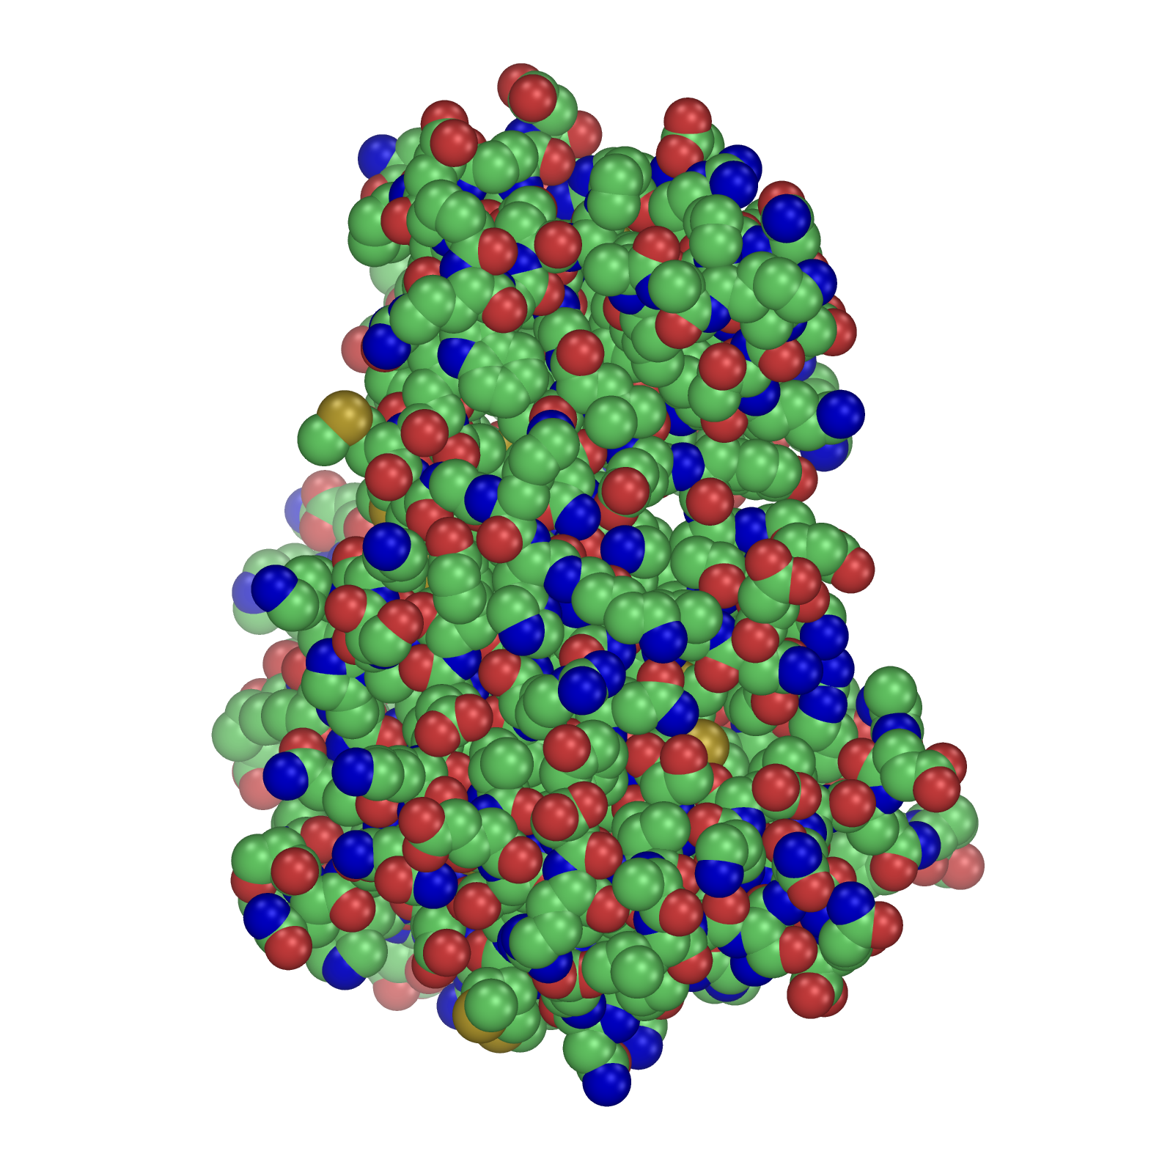
Protein Structure Visualization
Chemists are used to view molecules in 2D or as stick or ball-and-stick representation in 3D
This is not the best way to visualize a protein structure
Notes:
As the function of proteins is dependent on their 3-dimensional structure, visualization of protein structures is very important for structural biologists as well as for drug designers.
Chemists are used to work with 2D depictions of molecules or, when going 3D, to represent molecules as sticks, ball and stick or VdW spheres. To understand macromolecular structures these visualization methods are not optimal. Therefore other structure representation models are commonly used.

Slide 57
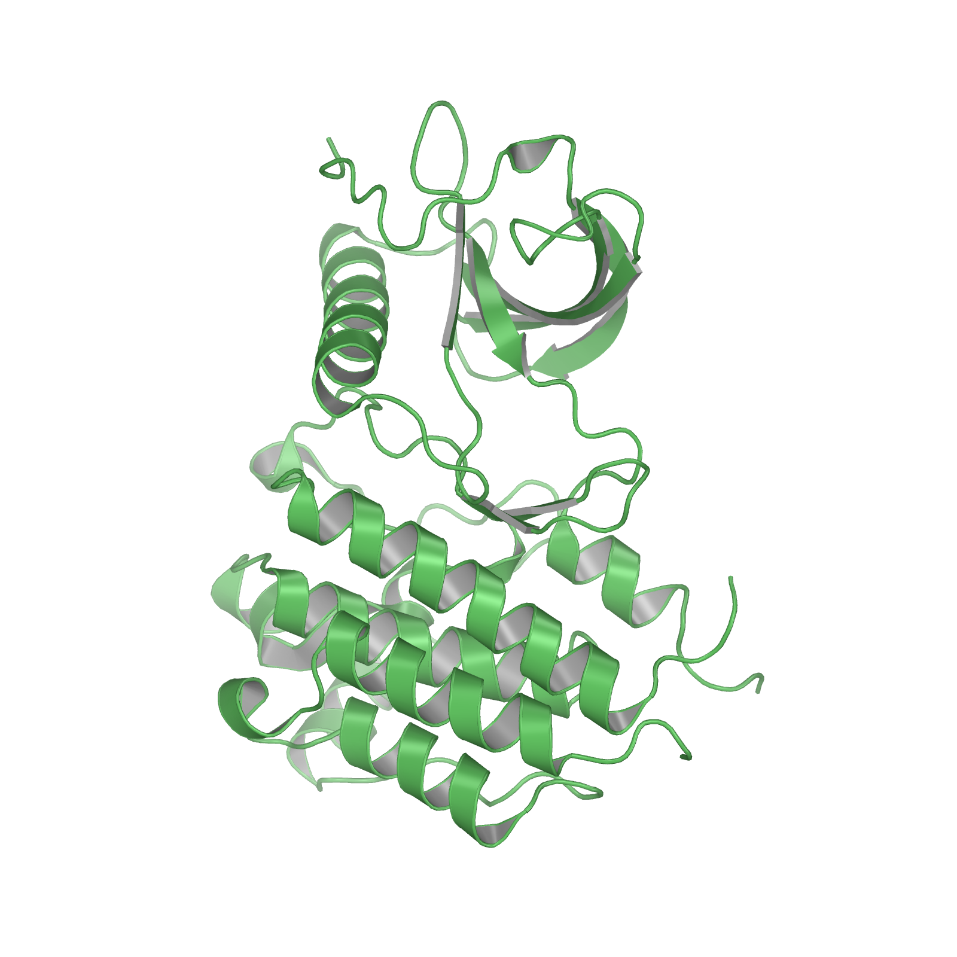
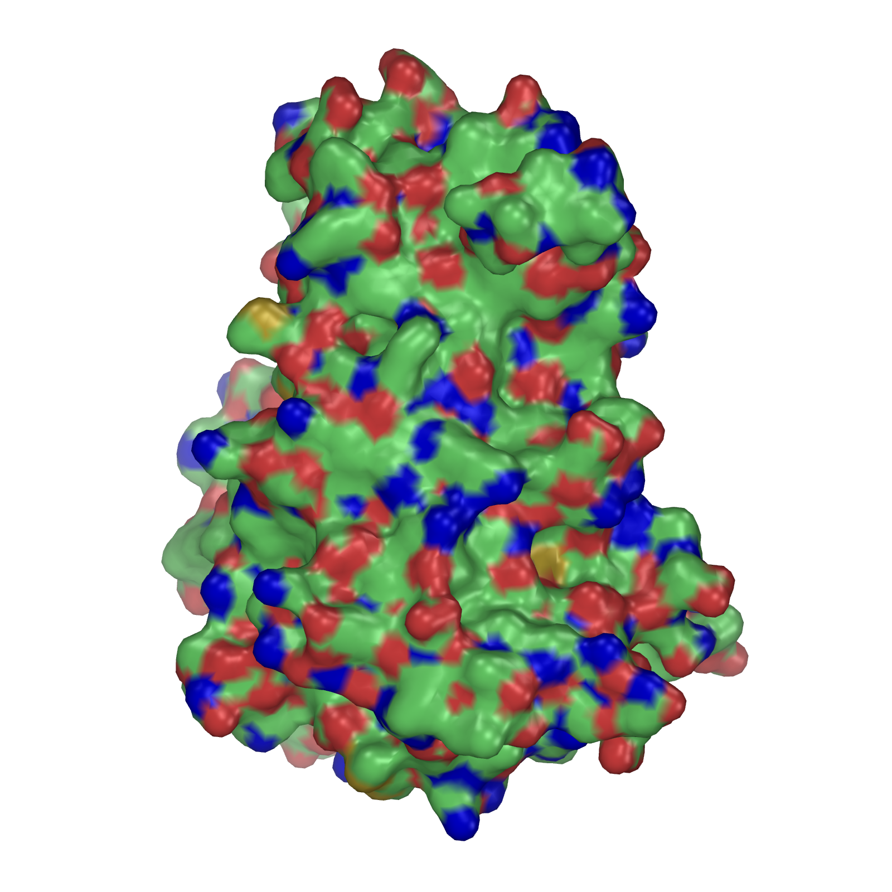
Cartoon representation of a protein
Surface representation of a protein
Notes:
On the left you see a so-called cartoon representation of protein. In this representation the secondary structure elements helix and sheet are represented in this characteristic way and regions which do not fall into these categories are represented as thin tubes along the backbone coordinates of the protein chain connect the different secondary structure elements.
Sidechains are or individual atoms are not shown at all in this representation.
The attractiveness of this visualization method is that the overall fold of a protein can easily be recognized and similarities to other proteins are obvious.
Another common visualization method is the representation of the protein surface. The surface is calculated using the vdw radii of all atoms. This is an important visualization for the purpose of drug design because it allows to detect cavities and pockets on the protein surface which are often binding sites for natural ligands or drug molecules.

Slide 58
Protein Structure Visualization Software
www.pymol.org
http://www.ks.uiuc.edu/Research/vmd/
https://www.cgl.ucsf.edu/chimera/
Notes:
There are several software packages for protein structures available, the ones shown here are available free of charge for academic use. Give it a try….

Slide 59
Membrane Proteins

Slide 60
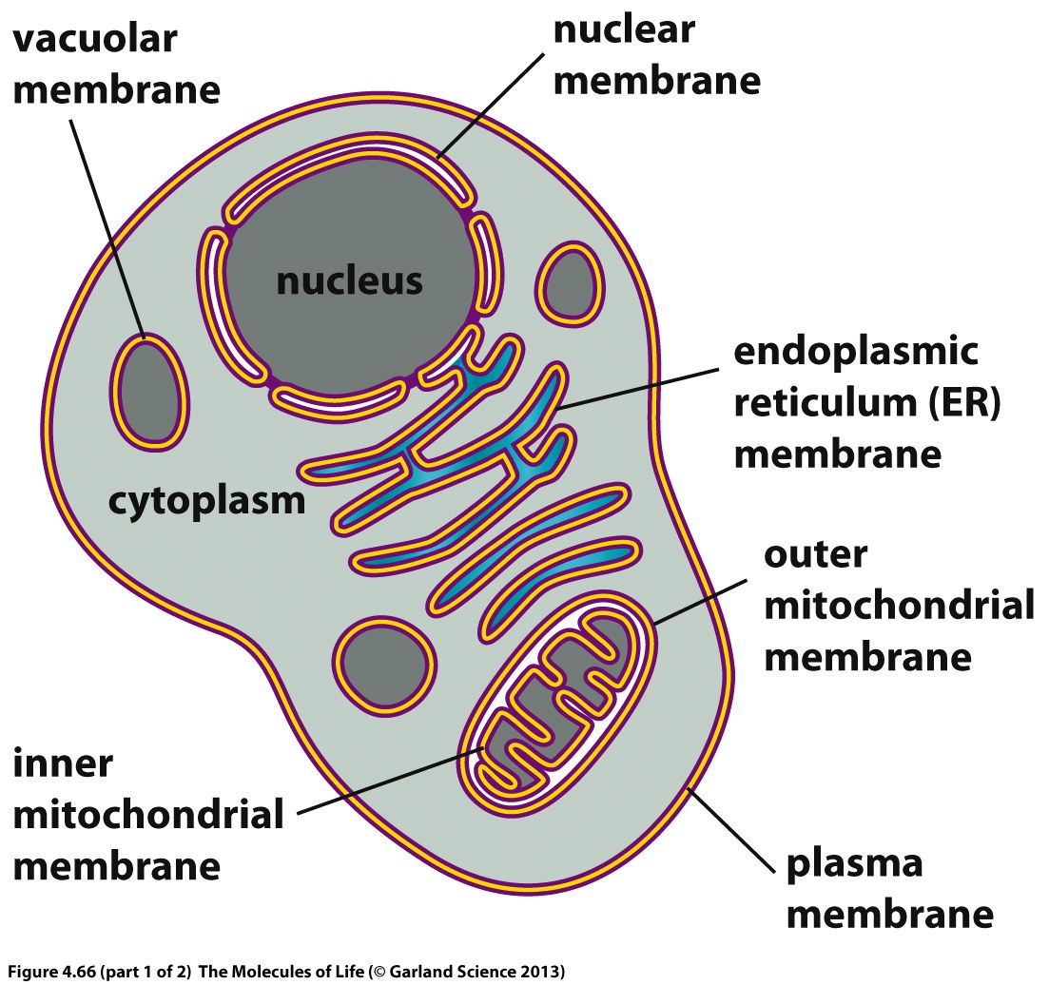

Slide 61
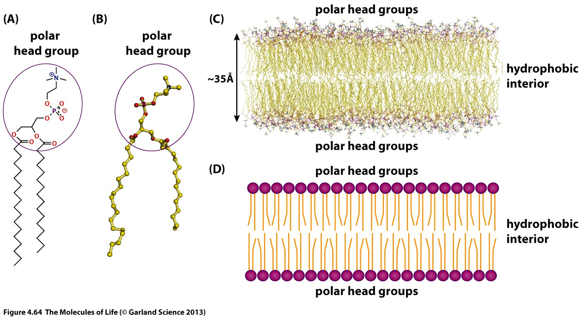
Biological membranes consist of phospholipids

Slide 62
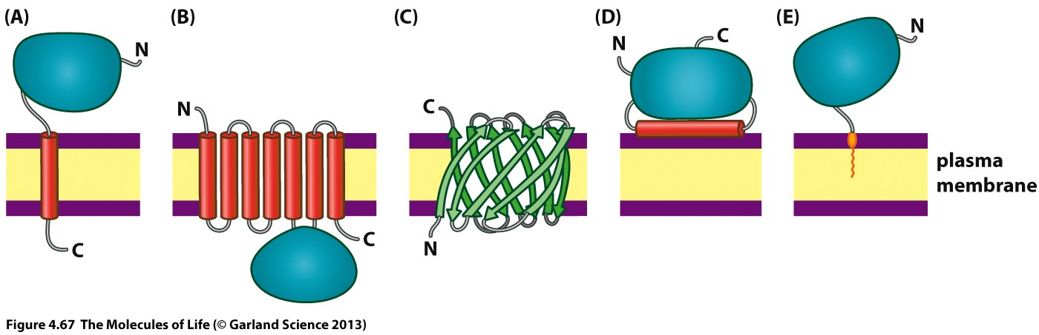
Proteins can be anchored to membranes or embedded

Slide 63
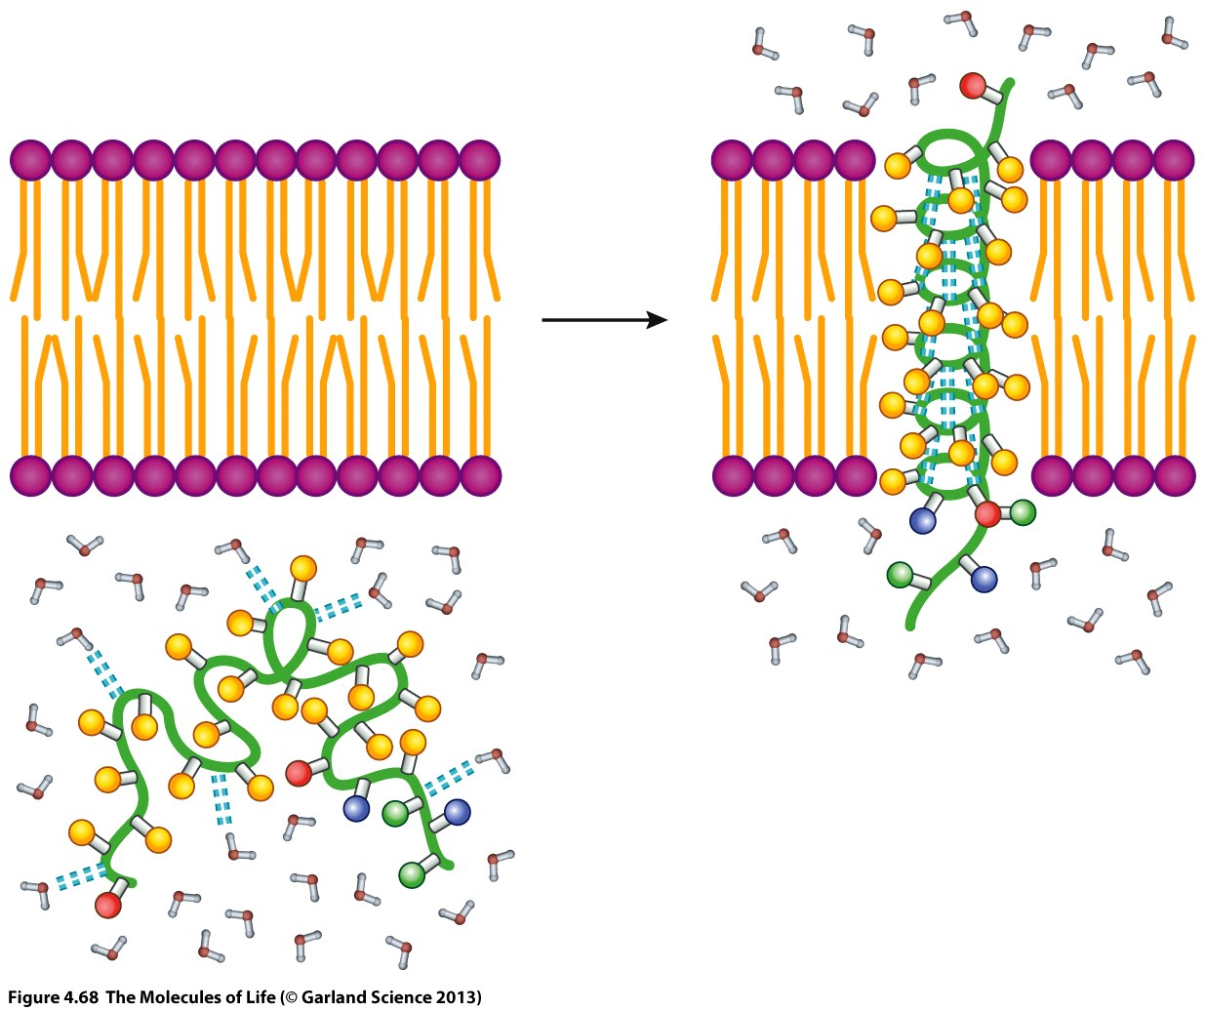

Slide 64
Experimental Determination of Protein Structures
Xray Crystallography (115790)
Solution NMR (11703)
Cryo Electron Microscopy (1471)

Slide 65
Xray Crystallography
1) Generate a protein crystal
2) Shoot at it with Xrays
3) Compute the electron density from the diffraction pattern
4) Generate a structure model which optimally fits to the electron density

Slide 66
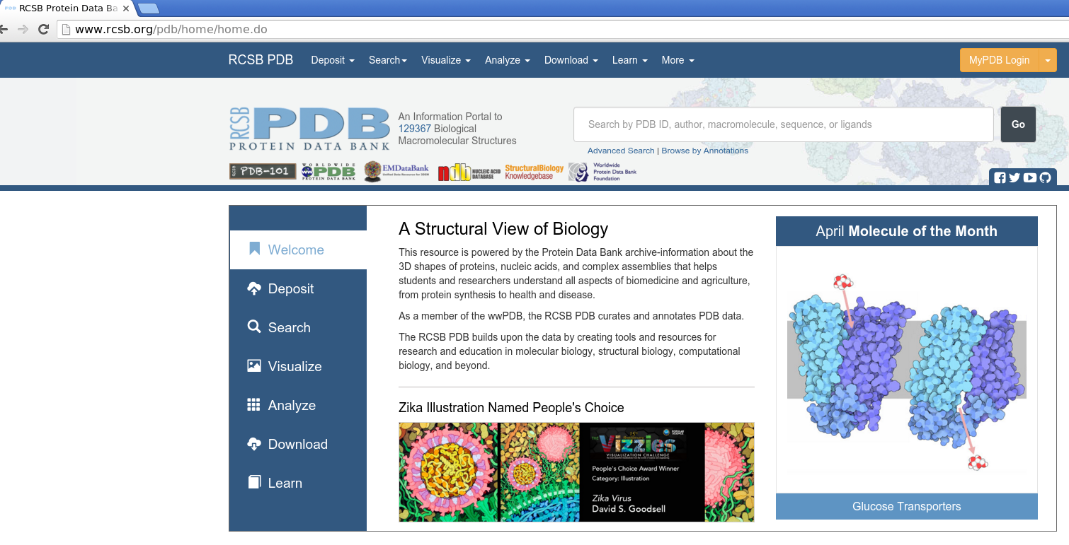
Protein Data Bank: http://www.rcsb.org

